Slide 1
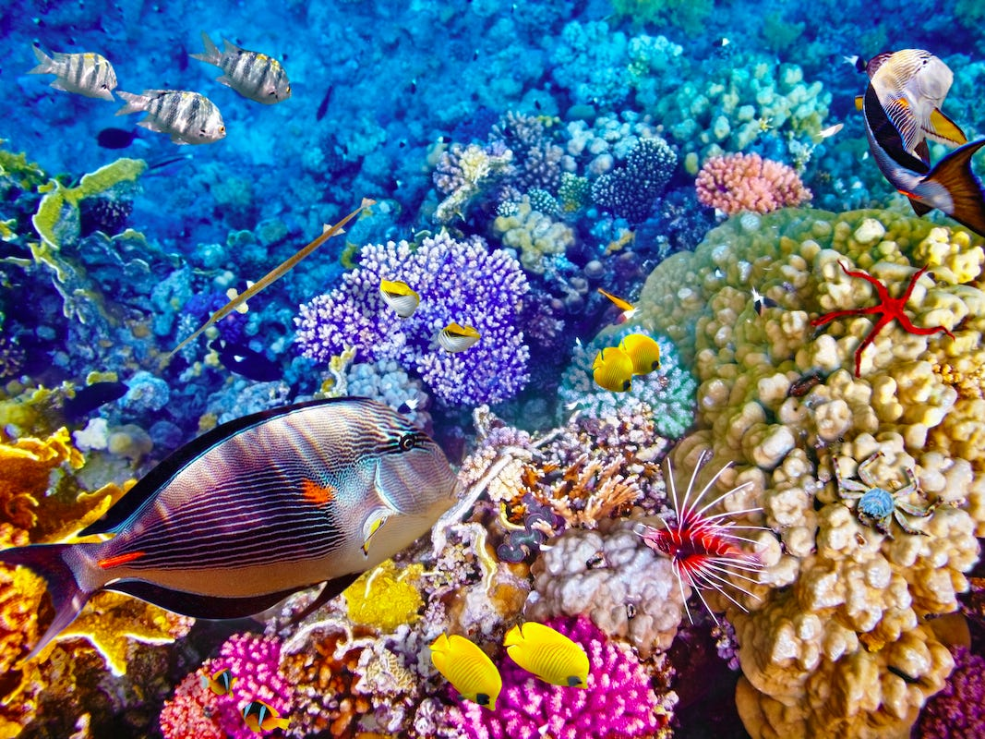
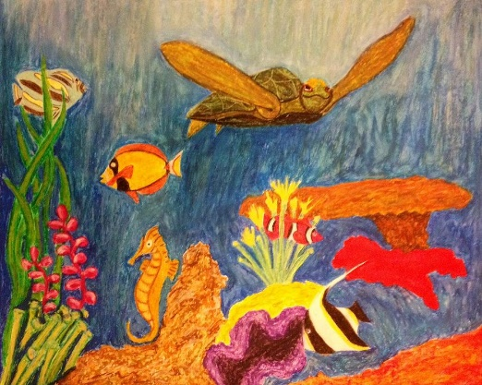
Teachers:
You need plain paper for each child to practise their blending on
You might want to use some masking tape to stick the sides of the paper down for each child (OPTIONAL)
Once all of your bubble complete their animals, it is up to you whether you would like to display them in your classroom (e.g. blue background for the sea)

Slide 2
L.O. To develop shading and blending techniques using colour.
Success Criteria:
I can sketch an animal using pencil.
I can use oil pastels to develop my knowledge of colour.
I can blend oil pastels using different techniques.

Slide 3
The Great Barrier Reef
The Great Barrier Reef is the world’s largest coral reef system.
It is comprised of reefs and islands that stretch over 2300 kilometres.
The reef is located in the Coral Sea, off the coast of Queensland, Australia.
It is known as the home of many sea life species and creatures.

Slide 4
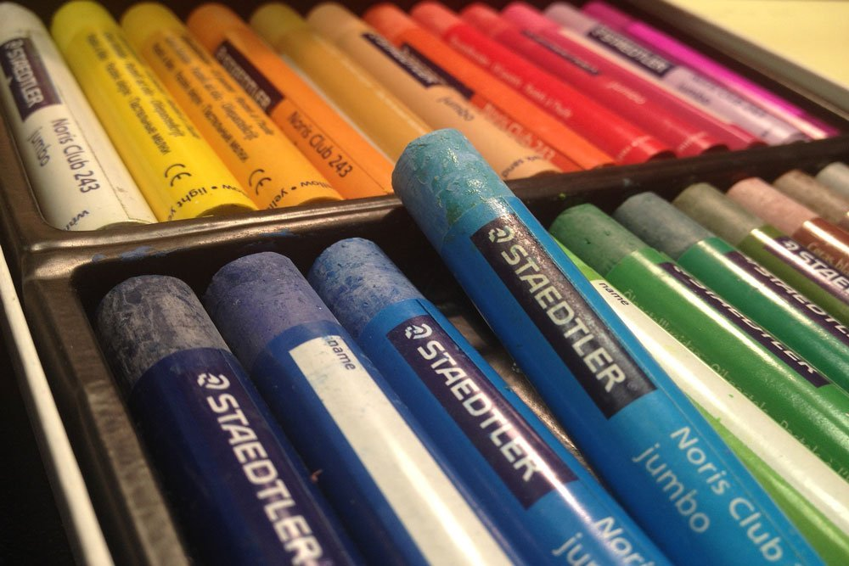
During this lesson, you will each be given an animal who lives in The Great Barrier Reef. You will be expected to sketch your animal and add colour to it.
The medium you will be using is
OIL PASTELS.

Slide 5
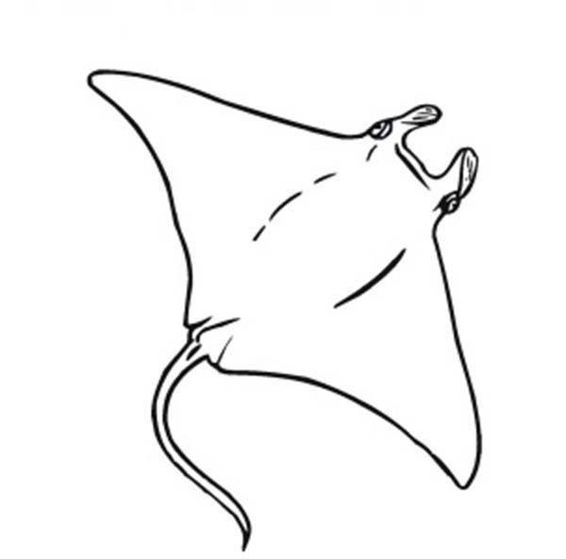
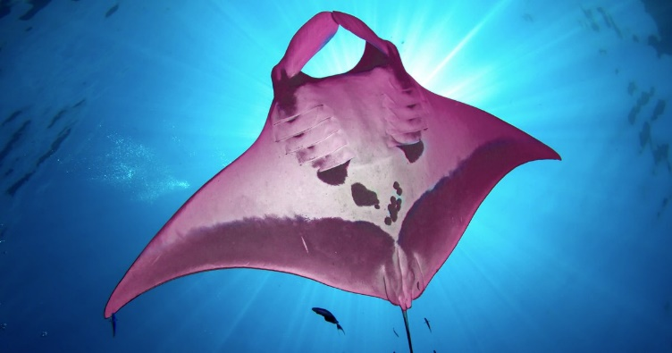
Task 1: Sketch the outlines of your animal
Use pencil to sketch the outline of your animal along with any features that the animal may have (remember to think about size and proportion).
For example:
Manta Ray
If you need help sketching, use your animal help sheet as a step by step guide.

Slide 6
Watch the video for how to blend: https://www.youtube.com/watch?v=wv7BSK6uatk
Task 2: Choose the colours you will need and practise blending on plain paper.
Which colour will you choose as a base?
How are you going to blend?
What works for you?

Slide 7
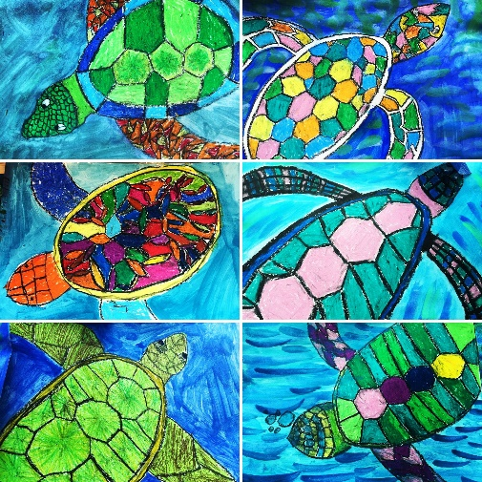
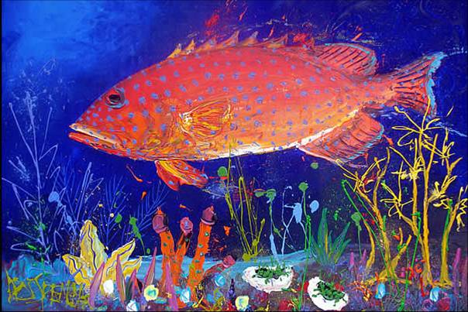
Now it’s time to apply your oil pastels knowledge to your work!
We can use different techniques when blending different coloured oil pastels together.
For example, you might choose to use your circular motions or a tissue.
You might want to begin with a lighter shade. You can always add darker layers afterwards.
Watch this helpful video (from 0.45 seconds) as a guide to follow…
https://www.youtube.com/watch?v=PHnfafU_R_Y

Slide 8
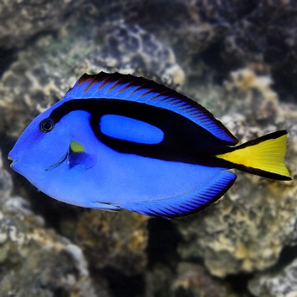
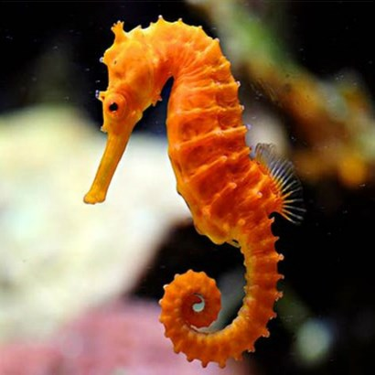
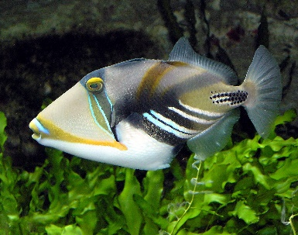
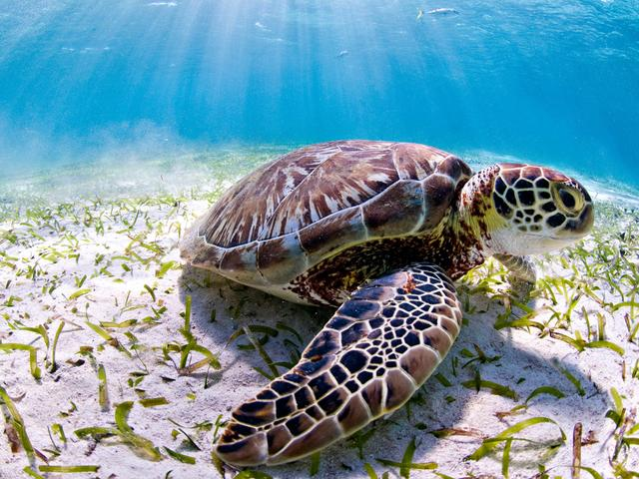
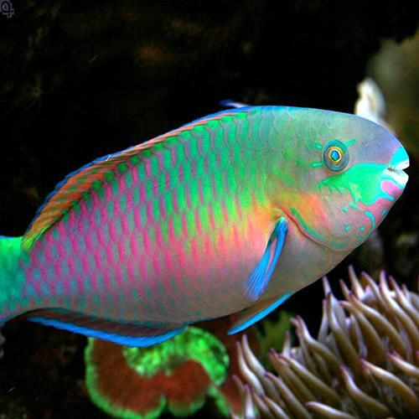
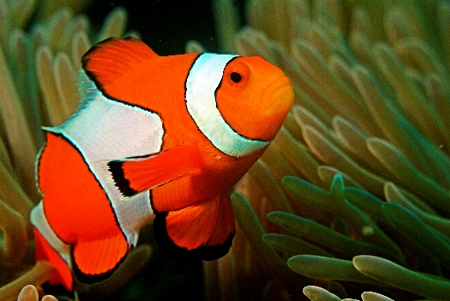
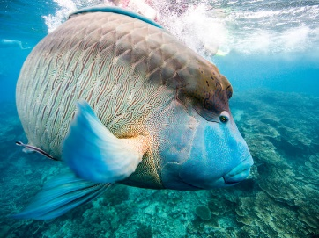
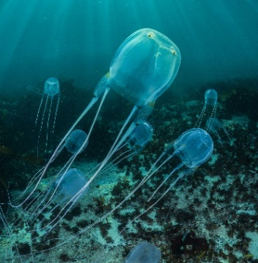
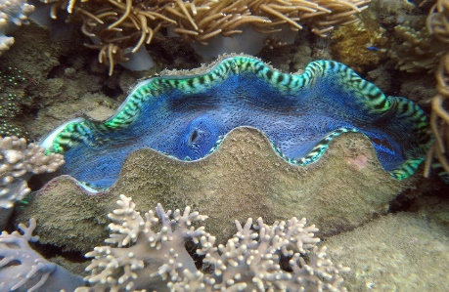
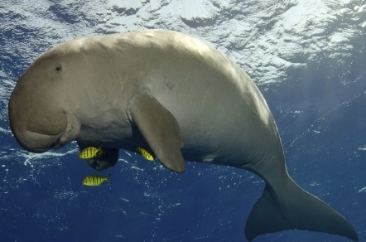
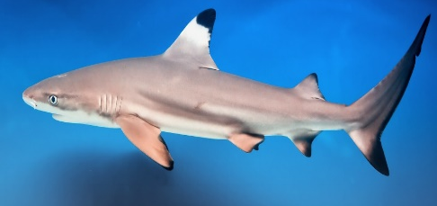
Task 3: Using what you have learnt in this lesson, apply oil pastels to your Great Barrier Reef animal sketch.
Remember! You can always practise on paper first before applying the oil pastel colour to your sketch.

