Slide 1
L.O. Food chains
I can explain what a food chain shows
I can recall key vocabulary associated with food chains.
I can create an accurate food chain based on animals in the Great Barrier Reef.

Slide 2
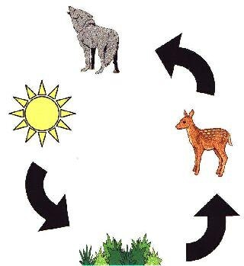
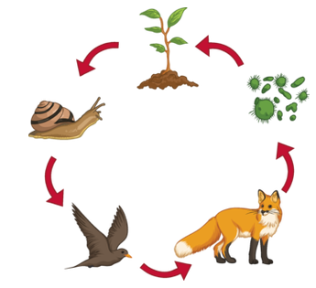
What does a food chain show?
It shows the flow of energy transferred through food.
The flow of energy is always shown with arrows!

Slide 3
Key vocabulary – do you know what they mean?
Consumer
Producer
Detritivore

Slide 4
Key vocabulary – do you know what they mean?
Consumer – anything that eats something else
(depending on number in the chain, we used terms primary, secondary, and tertiary consumer)
Producer – the first thing to be eaten
Detritivore – animal which feeds on dead organic material

Slide 5
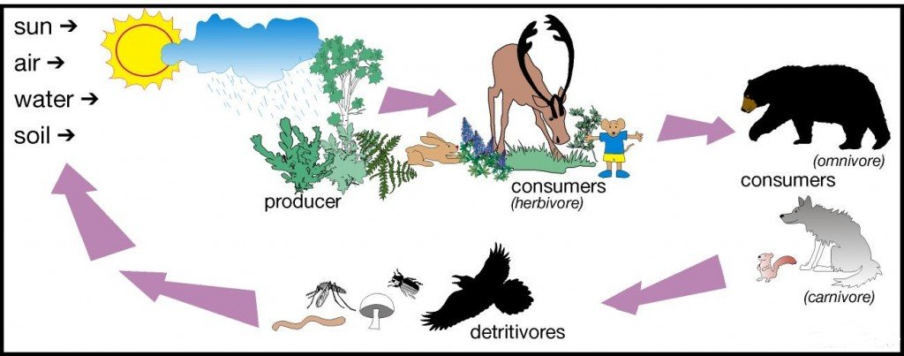
Food chains should always start with the sun. This gives the producer the energy it needs to grow.

Slide 6
The Great Barrier Reef – which animals on your sheet can you name?
Dugong
Clownfish
Humphead wrasse
Parrot fish
Manta rays
Potato grouper
Blacktip reef shark
Blue tang
Triggerfish
Krill
Phytoplankton
Seaweed
Seagrass
Sea turtle
Box jellyfish
Seahorse
Tiger shark
Giant clam
Marine algae
Molusc

Slide 7
Sometimes they’re called food maps. This is because an animal will have access to more than one type of food they will eat.
Let’s have a look at an interactive Great Barrier Reef food map
https://www.nationalgeographic.org/media/coral-reef-food-web/

Slide 8
Use the information pack to cut out the pictures of Great Barrier Reef animals and create your own Food map.
Remember, your food map must start with energy from the sun and the arrows must show the flow of energy,

