Slide 1
Maths Lesson 12
Children will need a mirror each.

Slide 2
L.O. Bar Charts
Problem of the day

Slide 3
L.O. Bar Charts
I can create a bar chart with support.
I can independently create an accurate bar chart.
I can create a bar chart with sub categories.
I can reason and problem solve with bar charts.

Slide 4
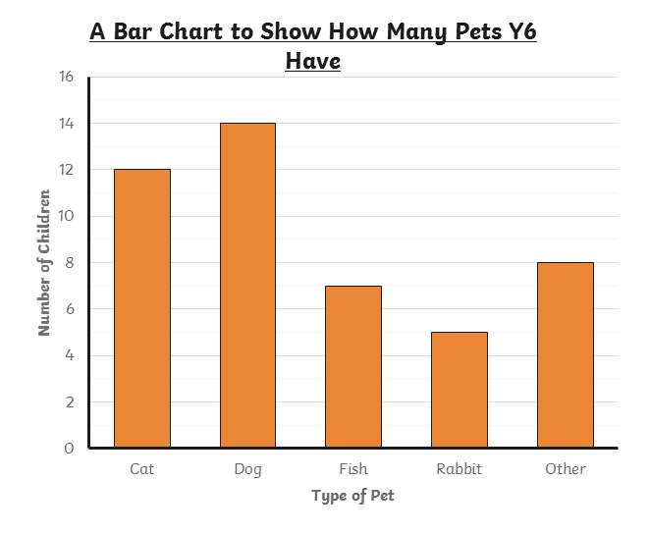
Discrete Data
Pet | Number of Children
Cat | 12
Dog | 14
Fish | 7
Rabbit | 5
Other | 8
Data that is counted and has no in-between value is called discrete data. Discrete data is usually collected in a frequency table and then presented as a bar chart.

Slide 5
A bar chart has a horizontal axis and a vertical axis.
A bar chart must always have a title explaining what it shows.
Bars must be carefully drawn to show the data.
There must be a gap between each bar.
Each bar must be the same width.
A number line is marked on the vertical axis. The scale of this number line is chosen based on the data range.
The data categories are organised on the horizontal axis.
Each axis must have a label explaining what it shows.

Slide 6
How many more children have a dog than a rabbit?

Slide 7
Here is the same bar chart with the scale counting up in 2s.
If there is an odd number, we have the bar stopping halfway between the numbers.
10
8
6
4
2
0
Red | Blue | Green | Yellow | Pink

Slide 8
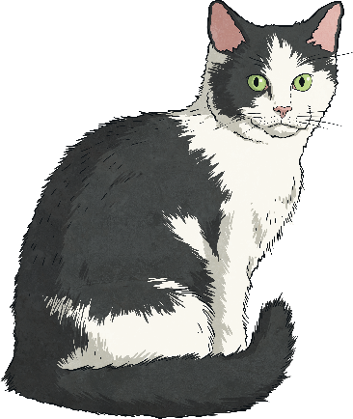
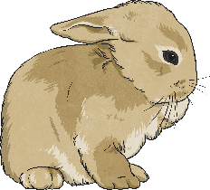
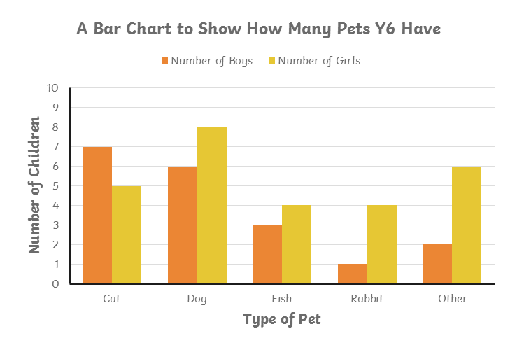
Discrete data in each category can also be represented in subcategories:
Pet | Number of Boys | Number of Girls
Cat | 7 | 5
Dog | 6 | 8
Fish | 3 | 4
Rabbit | 1 | 4
Other | 2 | 6
We can draw a grouped bar chart to show this data. In this bar chart, each category has more than one bar. A key is used to identify the subcategories of the data.

Slide 9
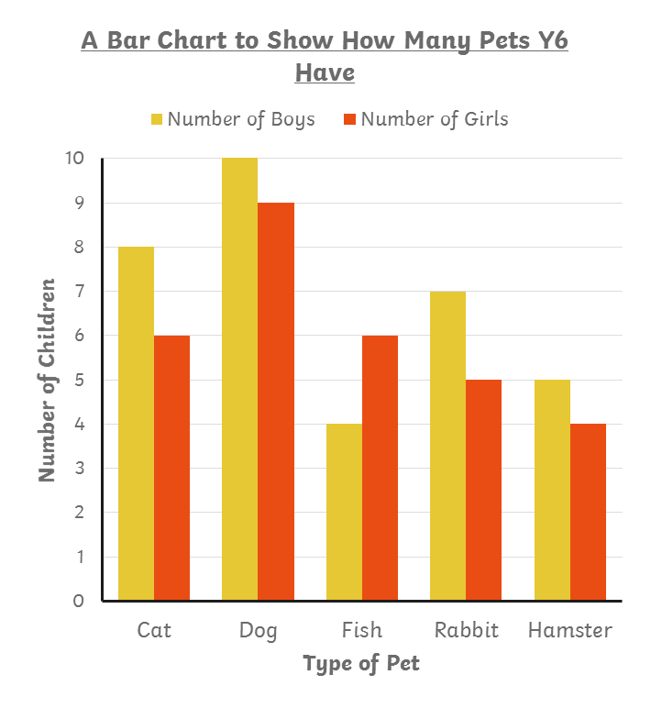
How many boys in year 6 have a fish or rabbit?
10
9
11
11
Try again!
Correct!

Slide 10
How many fewer girls in year 6 have a cat than a dog?
5
3
3
4
Try again!
Correct!

Slide 11
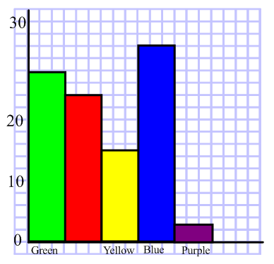
What is wrong with this bar chart?

Slide 12
Bar Chart v. Histogram
What are the differences?
What are the similarities?

Slide 15
How to make a bar chart 1. Create a frequency table.
Pet | Number of Children
Cat | 12
Dog | 14
Fish | 7
Rabbit | 5
Other | 8

Slide 16
How to make a bar chart 2 Use the numbers to plan your y ‘axis’
Pet | Number of Children
Cat | 12
Dog | 14
Fish | 7
Rabbit | 5
Other | 8

Slide 17
3. Label your axes

Slide 18
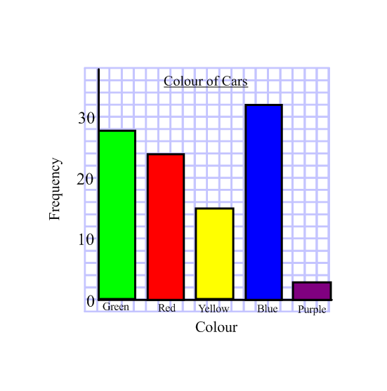
4. Plot your bars. Read the y axis carefully.
Did you leave gaps?

Slide 19
L.O. Bar Charts
I can create a bar chart with support.
I can independently create an accurate bar chart.
I can create a bar chart with sub categories.
I can reason and problem solve with bar charts.

