Slide 1
Maths Lesson 4
Gold will need plain paper. All will need a mirror .

Slide 2
L.O. Symmetry
5 a day
1. Write the value of each underlined digit
382,947 462,383 406,204 923,003
2. Complete the sequence
56, _, 36, 26, _, 6, _, -14
-4, -2, _, _, 4, 6
3. Write all factors of:
30 64 67
4. Find the squared and cubed numbers for each number below:
4 6 9
5. List all prime numbers to 20

Slide 3
L.O. Symmetry
I can explain what symmetry is.
I can create a symmetrical image.
I can think carefully about their uses in arcitecture and design.

Slide 4
WARNING: Team STEM assemble! ☺
This maths lessons includes science, DT AND Disney!

Slide 5
Symmetry- can you describe it in one sentence?

Slide 6
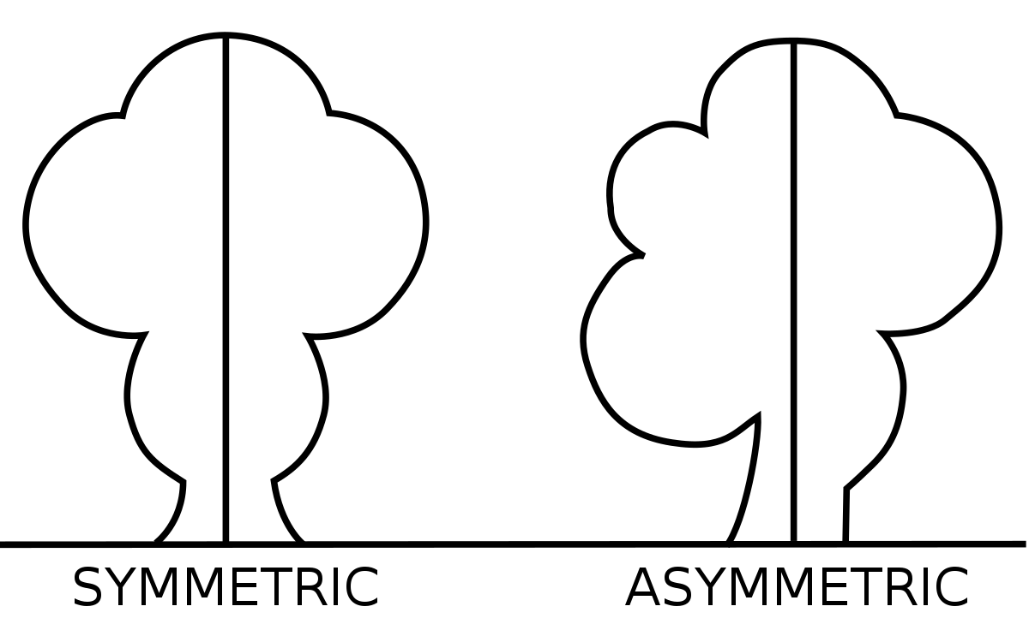
Symmetry
The quality of being made up of exactly similar parts facing each other or around an axis.

Slide 7
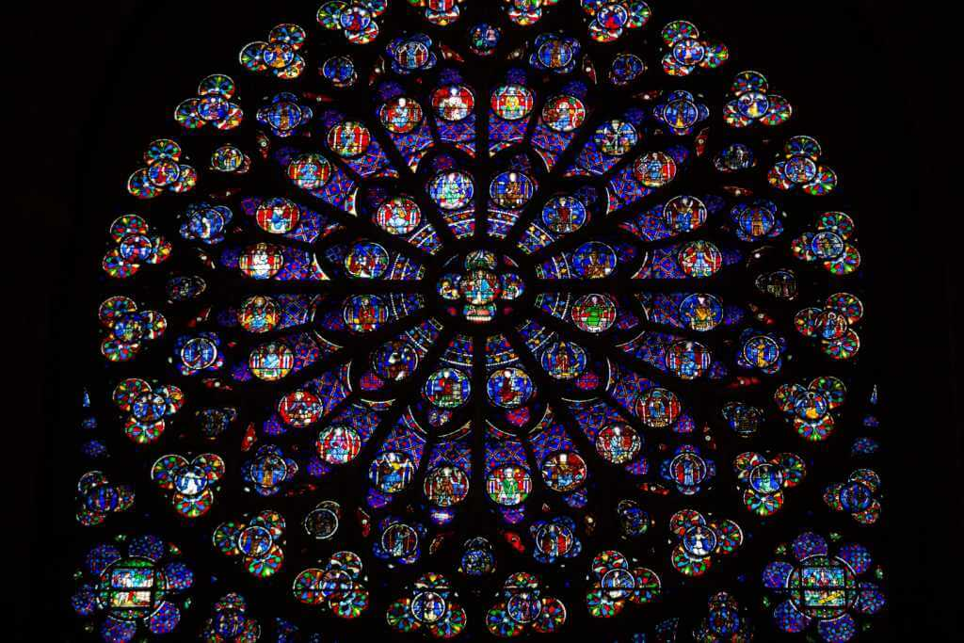
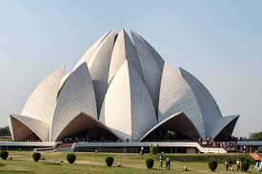
Symmetry has been used by architects and designers for years. Why do you think this is?

Slide 8
There are different types of symmetry:
Which do you think is which? Use your reading skills!
Radial Spherical Bilateral

Slide 9
There are different types of symmetry

Slide 10
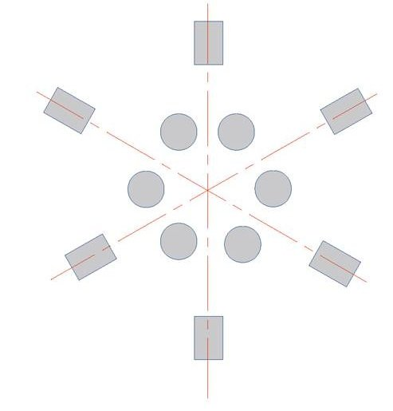
Radial Symmetry
Has a centre and a repetitive or continuous surrounding context.
Often seen in stadiums or theatres.
The radial structures simply place emphasis on the central area of a structure or place.

Slide 11
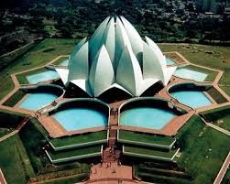
This is The Bahai House of Worship (Lotus Temple) in Delhi, planned in radial symmetry to create a large central void which is used as worship.

Slide 12
An example of radial symmetry is Rose window of Notre Dame Cathedral, Paris.

Slide 14
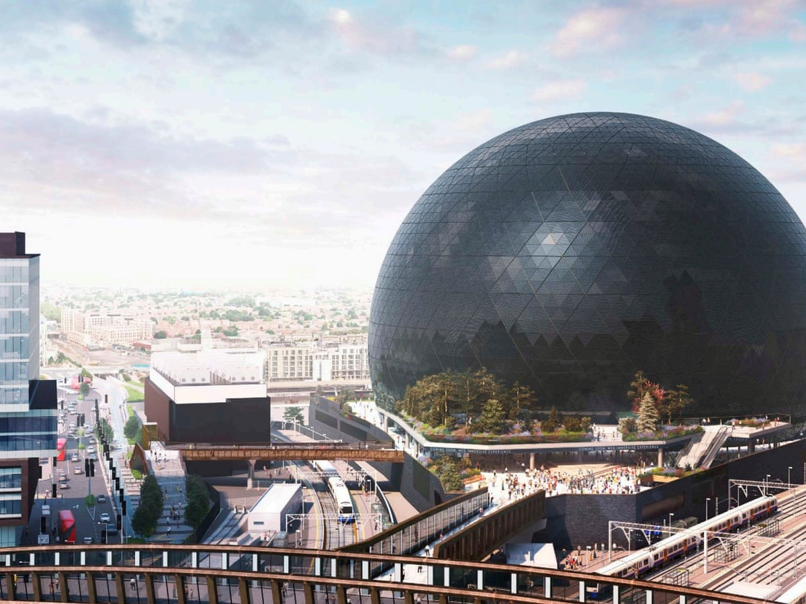
Spherical Symmetry
A perfectly round building is a feat of engineering that instantly creates a sense of allure, perhaps because of its resemblance to the shape of our own planet.
MSG Sphere- Vegas

Slide 15
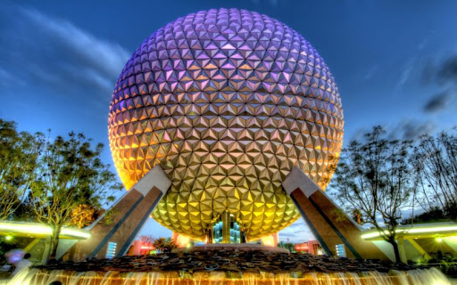
Spherical Symmetry
Walt Disney World’s Epcot, Spaceship Earth (you’re welcome Miss Martin ☺)

Slide 16
Ericsson Globe (Stockholm, Sweden) -The largest hemispherical structure on earth. -An arena and event space designed by Svante Berg and Lars Vretblad. --In addition to housing concerts and sporting events, the globular building acts as the sun in the Sweden Solar System, the world’s largest permanent scale model of our closest celestial bodies.

Slide 17
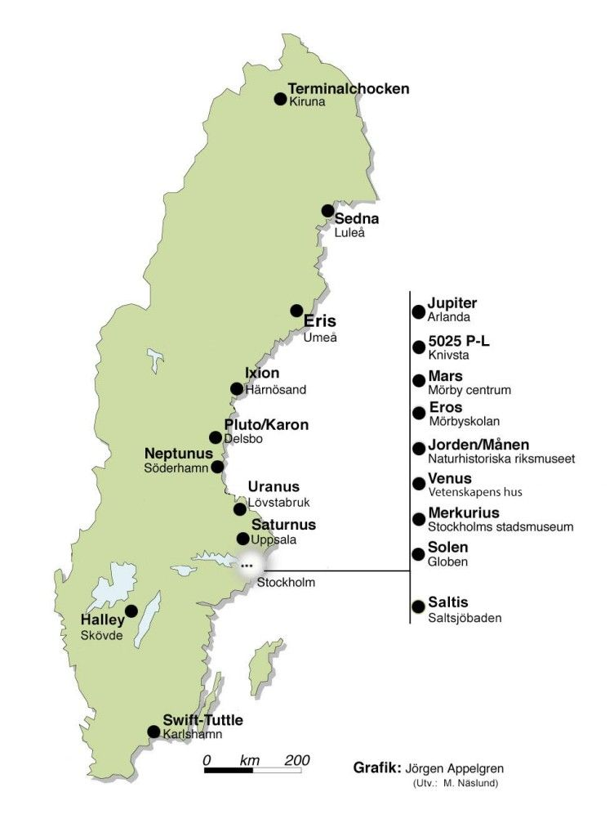
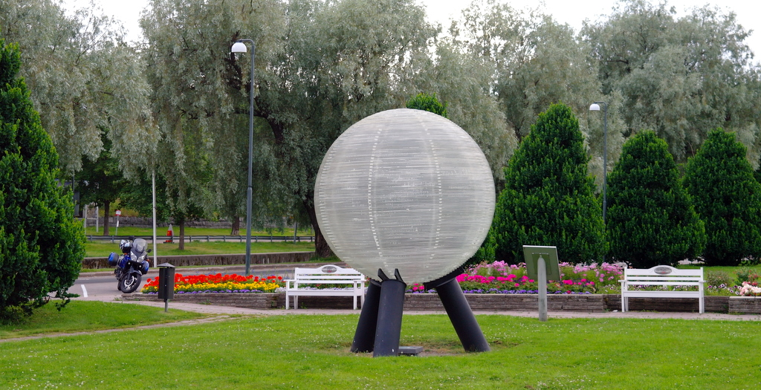
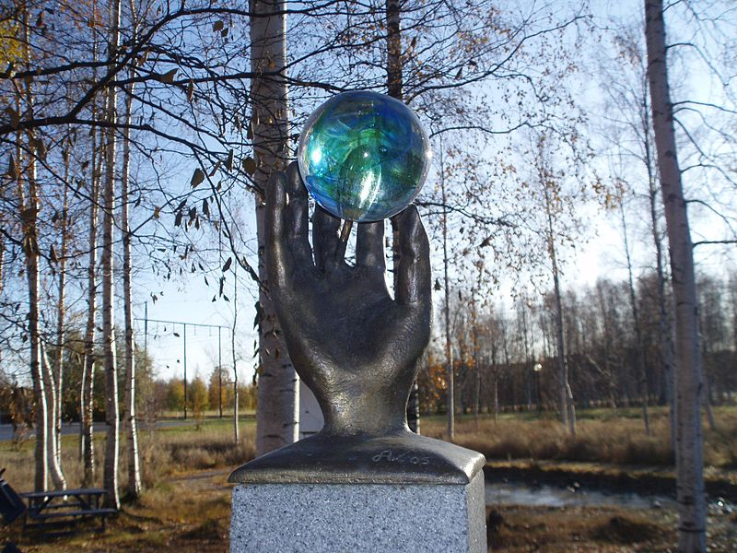
(In case you were interested in the Sweden Solar System!)

Slide 18
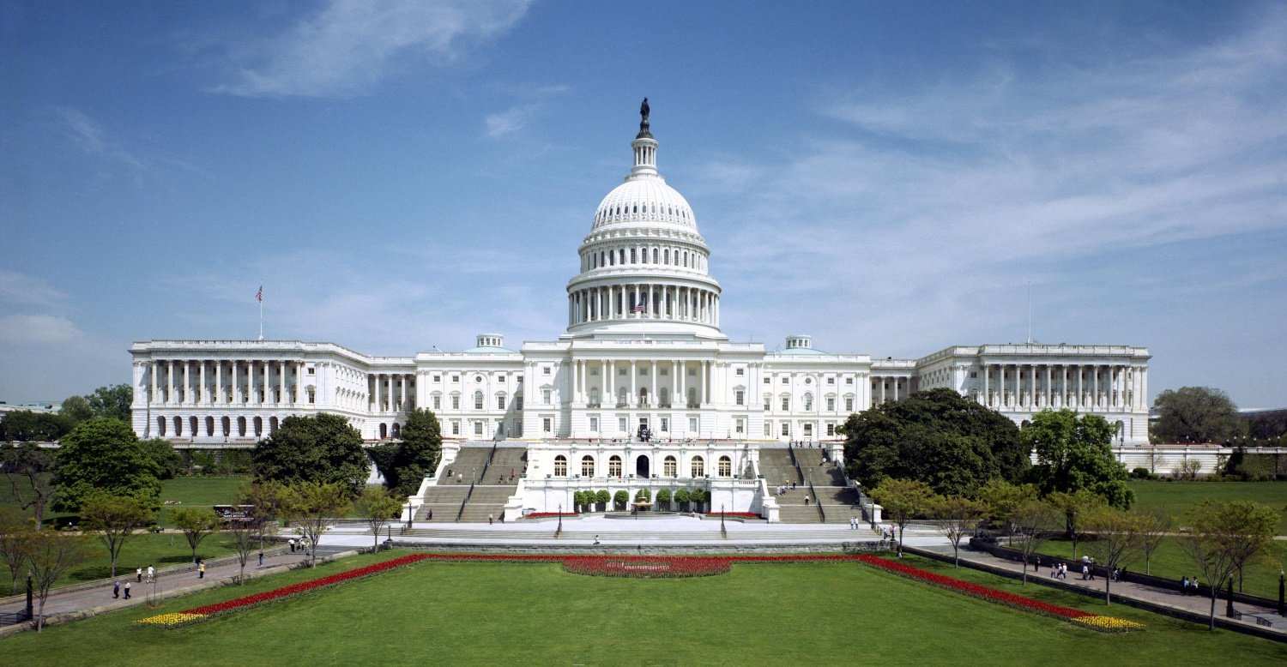
Bilateral Symmetry
Contain a single line of symmetry. Both sides are mirrored perfectly. The English prefixes bi-, derived from Latin means “two.”

Slide 19
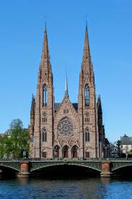

Slide 20
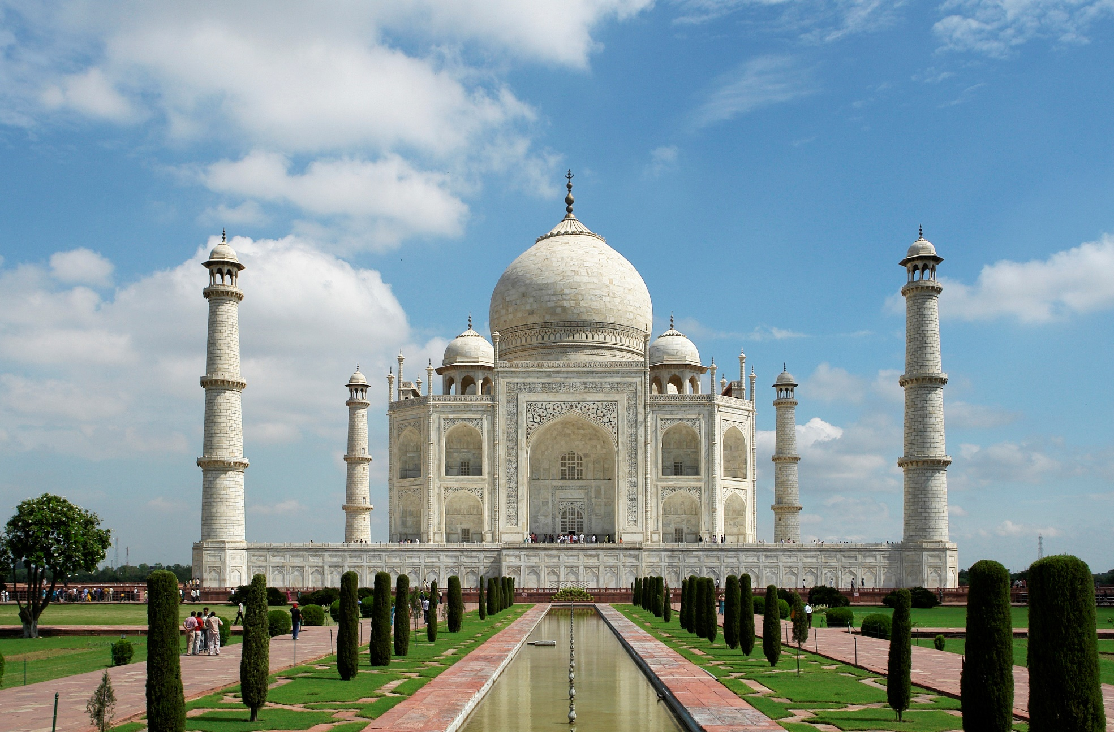
Why type of symmetry does the Taj Mahal have?

Slide 21
Bilateral Symmetry!
The Taj Mahal is a perfect symmetrical planned building, with an emphasis of bilateral symmetry along a central axis on which the main features are placed.

Slide 22
L.O. Symmetry
Stick your work in your book. Use a mirror to help you.
Bronze- Trace the other half of the Taj Mahal and colour it in so it is symmetrical.
Silver- Complete the other side of the Taj Mahal image, ensuring it has bilateral symmetry.
Gold- Design your own building which includes either bilateral, spherical or radial symmetry. Think carefully about the use of your building when designing it.

