Slide 1
Maths Lesson 7
Chn need a calculator

Slide 2
L.O. Budgeting
Problem of the Day
What mistake do you think Children make when answering this question?

Slide 3
L.O. Budgeting
I can plan a trip and find the total cost.
I can plan a trip within a budget.
I can plan the most cost effective trip within a budget.

Slide 4
What do these words mean?
Budget
Cost effective
Finance

Slide 5
What do these words mean?
Budget- a financial plan
Cost effective- something that is a good value, where the benefits and usage are worth at least what is paid for them
Finance- managing money

Slide 6
When might you need to create a budget?

Slide 7
Who watched Race Across the World?

Slide 8
Use the information given to you to plan a trip around South America. You want to travel for as many days and to as many places as possible before you run out of money. -Your budget is…

Slide 9
£10,000

Slide 10
Remember for each city:
Accommodation
Food
Transport

Slide 11
You can only take one flight each day. Flying is tiring remember ☺

Slide 12
Help sheet

Slide 13
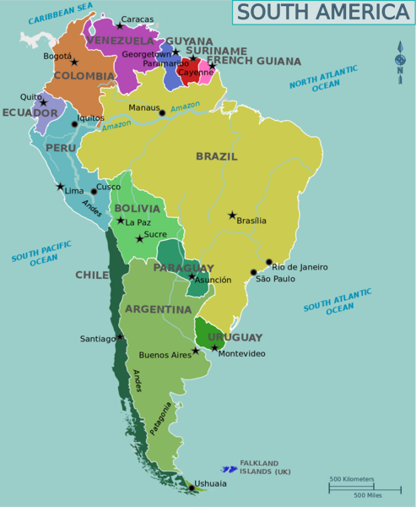
Everyone begins in Buenos Aires. What do the stars mean?

Slide 14
Step 1- flight
Plan your first flight path. I decide to travel to Bogota.

Slide 15
Find your flight cost.

Slide 18
Step 3
For each city you arrive in, add on accommodation, transport and food costs!

Slide 20
Why did I choose a taxi?

Slide 21
Day 1 Total = £1189

Slide 22
Day 2 I decide to travel next to Caracas. I repeat the same steps as before.

Slide 24
Do you think I can carry on travelling?
Did I budget well?
How do you know?

Slide 25
Day 1 + Day 2 = £1741
Do you think I can carry on travelling?
How do you know?

Slide 26
What if Day 1 + Day 2 = £9182
Should I carry on travelling?
Did I budget well?

Slide 27
Remember: You want to travel for as many days to as many places as you can. Planning your trip will take more than one attempt! So keep trying until you find the best trip.

Slide 28
L.O. Budgeting You can use a calculator!
Bronze- You have no budget! Plan a 5 day trip. What is the total cost? Use the sheet for help.
Silver-Use the planning sheet to help you with your first trip. Then, try on your own.
Gold- Work independently with no planning sheet for support.

