Slide 1
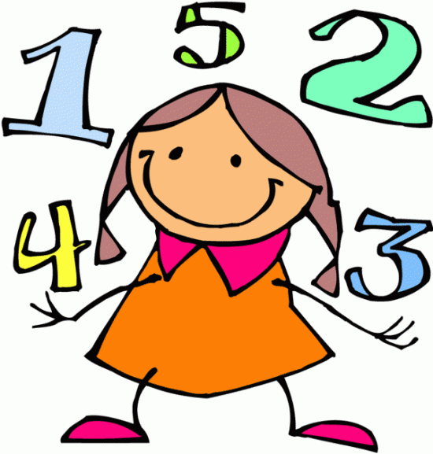
Maths at Boldmere Infant and Nursery School Year 2 Parent Information PowerPoint

Slide 2
KS1 Mathematics Curriculum
Welcome to our Year 2 Mathematics Presentation!
The aim of this presentation is to share with you how we teach Maths in Year 2, so that you can support your child with their Maths learning at home. We hope you find this information useful.

Slide 3
KS1 Mathematics Curriculum
The National Curriculum aims to ensure that all pupils:
Become fluent in the fundamentals of mathematics
Reason mathematically using a range of strategies and mathematical vocabulary.
Solve problems by applying their mathematics to a variety of routine and non-routine problems.

Slide 4
Main Principles in teaching Mathematics in KS1
Developing children’s understanding of number:
Through a variety of practical activities.
Through making links between activities.
Through applying Maths in different contexts.
Teaching children to understand concepts and methods – not simply the ‘tricks’ to get the right answer.
Securing basic number facts and mental calculations.

Slide 5
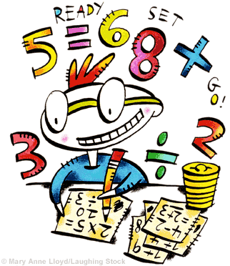
How do we teach in Year 2?
We expect all of our children to achieve the expected standard in Maths. Therefore, all children are taught to the expected standard and given the opportunity to achieve this.
ALL children have access to the same challenges/ activities during lessons.
This means that children are not ability grouped – this could lead to the achievement of some children being capped. Support is given to children as and when needed during lessons.

Slide 6
How do we teach in Year 2?
Daily Maths lessons are split into two sessions:
GUIDED MATHS
INDEPENDENT MATHS

Slide 7
How do we teach in Year 2?
GUIDED MATHS LESSON (Daily)
Children are taught as a whole class a
‘small step’ or skill e.g. adding a 1-digit
number to a 2-digit number.
The teacher and TA guide the children through this skill so that children become confident and secure through a variety of activities containing all 3 elements – concrete, pictorial, abstract. (further information on the CPA approach follows)
This session is heavily discussion based to draw out reasoning and vocabulary. Children will often work in groups or with a partner to provide opportunities for these discussions.
Children complete their working out in their maths jotters.

Slide 8
How do we teach in Year 2?
INDEPENDENT MATHS LESSON (Daily)
After the guided session, children have the opportunity to practise the small step independently.
Children work through the challenges at their own pace – challenge 1, challenge 2 and so on. They can access the challenges, which are usually kept in labelled baskets, independently.
During this session, the teacher and TA provide support to those children who may need additional practise – e.g. 1:1, small group work, completing a practical activity.
Those children who are demonstrating the ‘expected standard’ and require more of a challenge will be provided with greater depth activities where suitable.

Slide 9
Practising skills in a variety of ways
Children should demonstrate the skill being taught in 3 different ways and should be confident moving between them.
CONCRETE
PICTORIAL
ABSTRACT
This is called the CPA approach.
By doing this, children are demonstrating that they are working at the expected standard.

Slide 10
We start off with the concrete element – practical resources such as numicon, tens and ones, counters, bead strings. The children can see/ feel/ touch and move the concrete resources to help them visualise the learning.
The CPA Approach
Once children are confident using concrete resources, we then move on to pictorial – e.g. looking at pictures of objects, drawing their own tens and ones to represent a number.
The final step is recording the abstract number sentence.

Slide 11
What do we teach in Year 2?
Please see the grid of the objectives which are taught in Year 2 (attached separately.)
You can also see the ‘expected standard’ statements which the children are assessed against at the end of the year further on in this presentation. This will allow you to see the skills, knowledge and concepts that are taught throughout the year.
Underpinning all of the these objectives we have:
Fluency
Reasoning
Problem Solving

Slide 12
Fluency
When we think of fluency in reading, we think of children decoding the words without breaking them down into individual sounds. Children will read many of the words by sight.
Fluency in maths is the same – recalling facts for number bonds without having to work them out.
We aim to build children’s rapid recall of facts such as number bonds to 10, 20 and multiplication facts (2, 5 and 10) without having to work them out using their fingers, practical resources or by drawing pictures.

Slide 13
Fluency
+ | 0 | 1 | 2 | 3 | 4 | 5 | 6 | 7 | 8 | 9 | 10
0 | 0+0 | 0+1 | 0+2 | 0+3 | 0+4 | 0+5 | 0+6 | 0+7 | 0+8 | 0+9 | 0+10
1 | 1+0 | 1+1 | 1+2 | 1+3 | 1+4 | 1+5 | 1+6 | 1+7 | 1+8 | 1+9 | 1+10
2 | 2+0 | 2+1 | 2+2 | 2+3 | 2+4 | 2+5 | 2+6 | 2+7 | 2+8 | 2+9 | 2+10
3 | 3+0 | 3+1 | 3+2 | 3+3 | 3+4 | 3+5 | 3+6 | 3+7 | 3+8 | 3+9 | 3+10
4 | 4+0 | 4+1 | 4+2 | 4+3 | 4+4 | 4+5 | 4+6 | 4+7 | 4+8 | 4+9 | 4+10
5 | 5+0 | 5+1 | 5+2 | 5+3 | 5+4 | 5+5 | 5+6 | 5+7 | 5+8 | 5+9 | 5+10
6 | 6+0 | 6+1 | 6+2 | 6+3 | 6+4 | 6+5 | 6+6 | 6+7 | 6+8 | 6+9 | 6+10
7 | 7+0 | 7+1 | 7+2 | 7+3 | 7+4 | 7+5 | 7+6 | 7+7 | 7+8 | 7+9 | 7+10
8 | 8+0 | 8+1 | 8+2 | 8+3 | 8+4 | 8+5 | 8+6 | 8+7 | 8+8 | 8+9 | 8+10
9 | 9+0 | 9+1 | 9+2 | 9+3 | 9+4 | 9+5 | 9+6 | 9+7 | 9+8 | 9+9 | 9+10
10 | 10+0 | 10+1 | 10+2 | 10+3 | 10+4 | 10+5 | 10+6 | 10+7 | 10+8 | 10+9 | 10+10

Slide 14
Reasoning
Why?
In order to give the children a deeper understanding about the skills that they have learnt, we teach them to reason – to explain and discuss their work with other children and adults.
This allows us to see that they have really grasped a deepened understanding of mathematical concepts.
Children should be able to explain how they have solved a problem and explain how they know why a problem is correct/ not correct, rather than just following a ‘trick’ to solve an answer.

Slide 15
Problem Solving
This is when children solve problems and apply the skills that they have learnt.
It puts the maths into real life situations and contexts – for example money and shopping.
Here is an example:
Instead of simply solving subtraction number sentences, children are given opportunities to problem solve.
This requires them to understand what the problem is asking and choose which operation they need to use in order to solve it.

Slide 16
Problem Solving
How many different 2-digit numbers can you make using these digits?
How do you know that you have them all?
4 8 2 7
Which is the largest? Smallest?
How many numbers can you make that are greater than 50?

Slide 17
Anchor Tasks
All lessons start with an ‘anchor task’ which is always a problem solving activity.
During the guided part of the lesson, we introduce the anchor task and draw out the maths that the children would use to solve the problem.
This involves a lot of discussion in order to encourage the children to explain their thinking and reasoning.

Slide 18
Anchor Tasks
Here are some examples of anchor task problems:

Slide 19
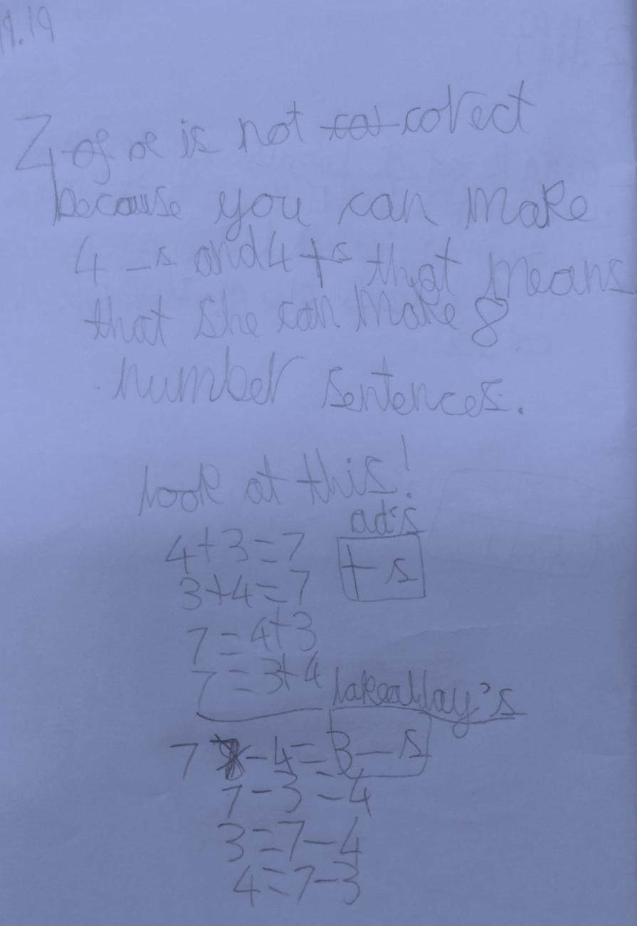
Children will often use their jotters during the guided session to solve the anchor task.
We encourage the children to explain their reasoning, not just simply find the answer.
Here is an example of a child showing ‘how they know’ in their maths jotter.

Slide 20
Here is an example of progression using the CPA (concrete-pictorial-abstract approach) during a guided maths lesson.

Slide 21
Concrete:
Can you use double sided counters to represent these flowers?
What can you tell me about the flowers?
Can you represent the flowers in a different way?

Slide 22
Pictorial
Can you draw a part-part whole diagram to represent the flowers?

Slide 23
Draw the part-part-whole diagram to match these flowers.
(Revisit and discuss what a part-part whole is, which is the whole, which are the parts) How do we know which numbers will go in the parts and whole?)

Slide 24
7
3
4

Slide 25
Abstract
What number fact sentences can you make from this part-part whole diagram?
7
3
4

Slide 26
What number fact sentences can you make from this part-part whole diagram?
7
3
4
3+4=7
4+3=7
7-3=4
7-4=3

Slide 27
7
Can you represent the picture of the flowers using a bar model?
How are you going to split the bar for the parts? Why?
(Children would discuss how big/ small the bars need to be depending on the value of the numbers)

Slide 28
I have used the part-part whole to write my numbers facts.
6 + 3 = 9
3 + 6 = 9
6 = 9 + 3
6 = 3 + 9
6 – 9 = 3
9 – 3 = 6
6 = 3 + 9
3 = 9 - 6
(The children would then have the opportunity to have a go independently – e.g. by adding a few more flowers)
Can they follow the CPA approach again independently without guidance?
Do you agree with Tom? Why/why not? Convince me.
Can the children identify Tom’s mistakes and explain why he is incorrect?

Slide 29
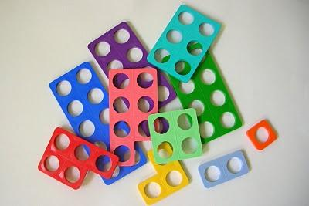
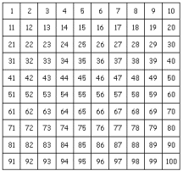
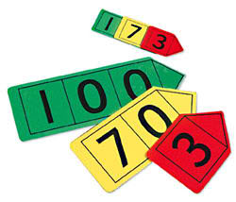
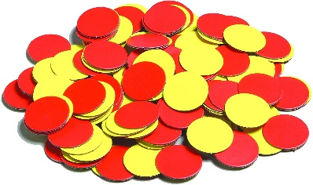
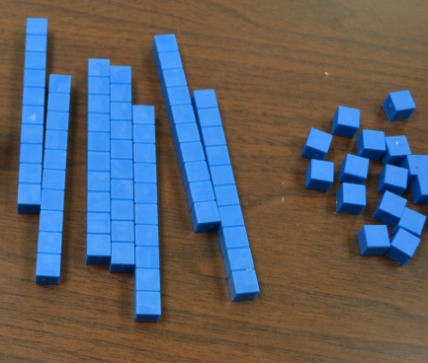
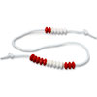
Resources
Here are some of the resources children have access to during lessons in their Maths toolkit boxes.
Number line
Number (hundred) square
Numicon
Counters
Bead Strings
Tens and ones (base 10)
Place value cards

Slide 30
The 4 Operations
In the following slides, you can see some of the methods and ways we teach the four operations in school using the CPA approach through videos and pictures.
We hope you find this useful in understanding how Maths is taught within school.

Slide 31
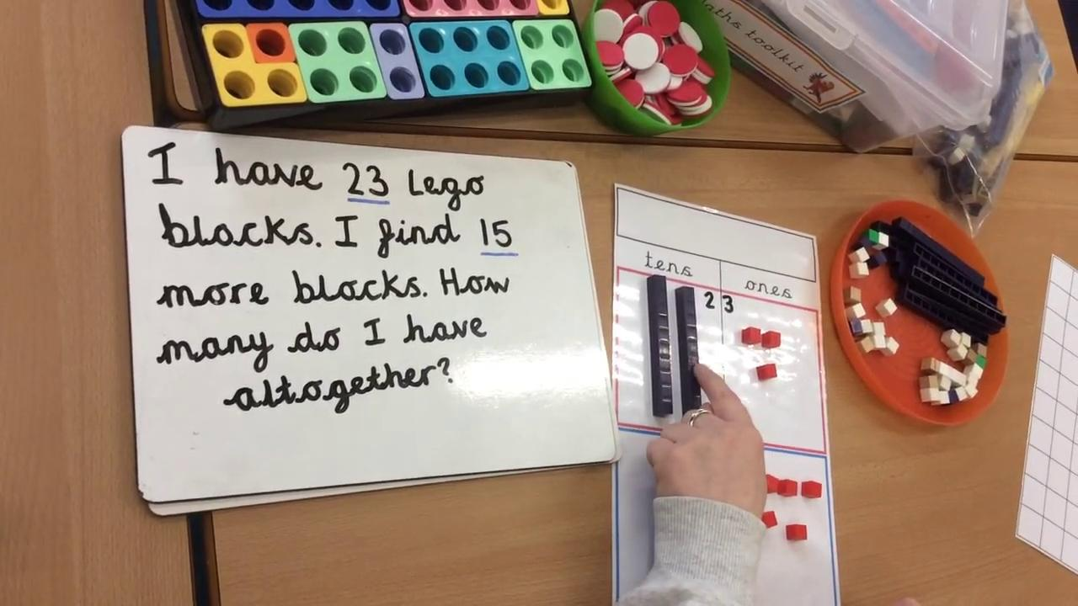
Addition
Please watch the video below to see an example of how we would solve an addition problem using the CPA approach (concrete-pictorial-abstract) during a Maths lesson. We would use tens and ones to help solve the problem.

Slide 32
Addition
Below is an alternative example of how children could solve addition problems using pictorial representations (instead of drawing tens sticks and ones) after practising this practically using counters.
Children would draw the number of counters for the amount they are adding and simply ‘count on.’

Slide 33
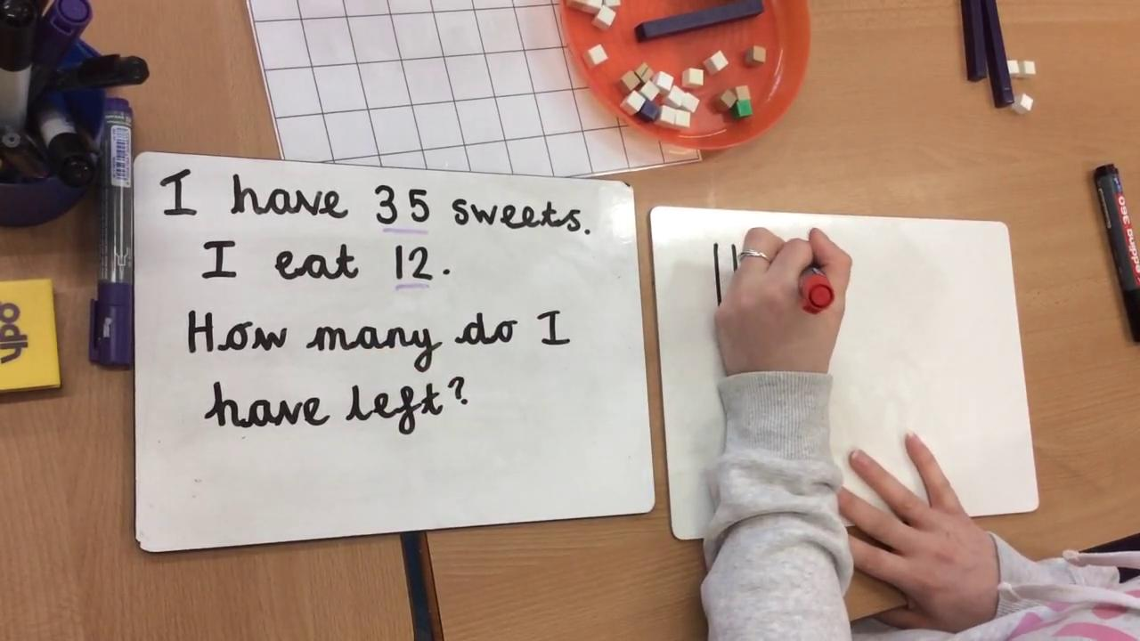
Subtraction
Please watch the video below to see an example of how we would solve a subtraction problem using the CPA approach (concrete-pictorial-abstract) during a Maths lesson by using tens and ones.

Slide 34
Subtraction
Below is an alternative example (to using tens and ones) of how children could solve subtraction problems using pictorial representations after practising this practically using counters.
Children would draw the number of counters for the amount they are subtracting and simply ‘count back.’
Here is an example of how we would subtract using tens and ones if the children need to ‘exchange.’
If the amount of ones we need to subtract is more than the ones in the original number, we must ‘exchange’ a tens stick for ten ones before subtracting.

Slide 35
Multiplication
Throughout the year, we practise recalling the 2, 5 and 10 times tables in order to build the children’s rapid recall of the times tables.
When teaching multiplication, we also teach the children to use arrays. Here is an example of solving the problem 4 x 5
The children would then move on to drawing their own array and writing the abstract number sentence too.
Firstly, the children would do this practically – 4 rows of 5.

Slide 36
Division
When teaching the children to divide, we would practise ‘sharing’ items to solve the problem.
For example, 15 ÷ 3 =
Next, the children would draw the groups (the amount we are dividing between) and share the objects. This could also be drawn instead.
The final step would be counting and recording the abstract number sentence.
Firstly, the children would count out the objects using concrete objects.

Slide 37
Year 2 Expectations
At the end of the year, your child’s attainment will be measured against national expectations through teacher assessment (ongoing throughout the year) and SATs. Your child will be judged as either:
Working towards the expected standard
Working at the expected standard
Working at the expected standard with Greater Depth

Slide 38
Year 2 Expectations
Here is a list of the expected standard statements for Maths in Year 2 which your child will be assessed against.

Slide 39
How Maths is assessed
Teacher assessment
Arithmetic
Problem solving and reasoning
2 ‘SATs’ Tests
The SATs tests are carried out during the month of May and are kept very ‘low key’ – the children are very much unaware of the SATs and simply think they are doing a quiz!
When children are not taking the tests, they are completing lots of fun activities and crafts. Further information will follow later on in the year regarding SATs.

Slide 40
Online games and resources
Children love games to engage their learning. Try some of these links.
Additional games and websites:
https://www.ictgames.com/
https://www.mathletics.com/uk/
Your child will have received their Mathletics log on and information from their class teacher. All activities set link to your child’s learning in the classroom. Many of these activities your child will be able to complete independently.
BBC Bitesize:
https://www.bbc.co.uk/bitesize/subjects/zjxhfg8
Top Marks:
https://www.topmarks.co.uk/

Slide 41
Thank you for taking the time to read this presentation.
If you have any further questions, please feel free to email:
yr2-contact@boldmere.bham.sch.uk
Thank you for your continued support,
The Year 2 Team

