Slide 1
L.O: To research a historical figure
Success Criteria:
I can understand what an archaeologist is
Retrieve information from different sources
Retell key findings in a storyboard

Slide 2
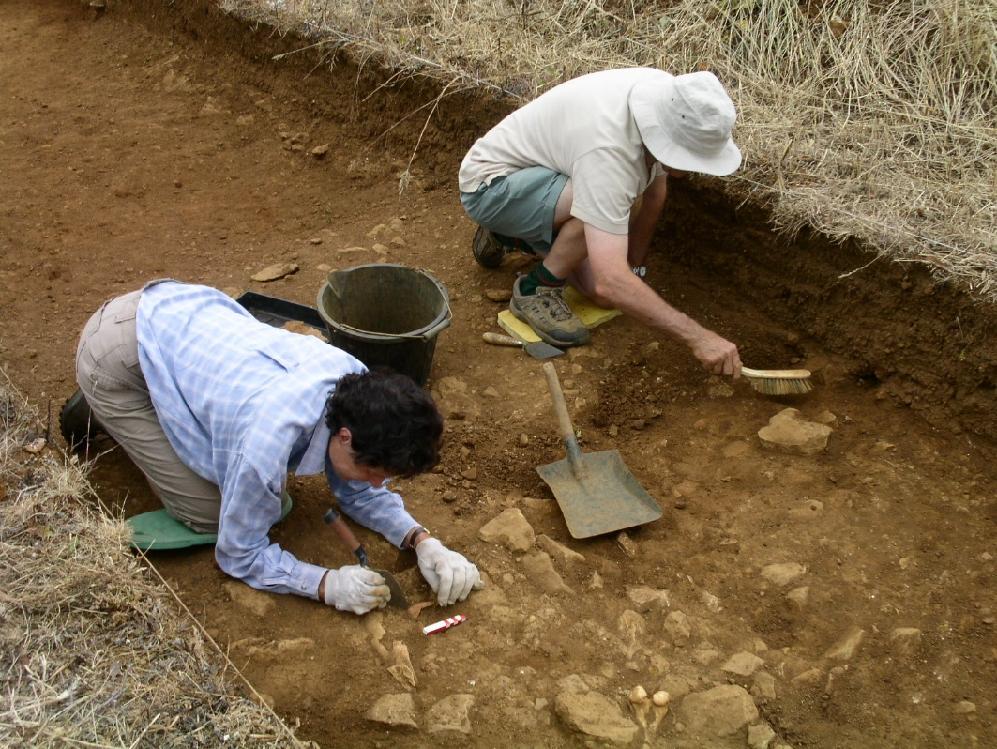
Key Vocabulary
Archaeologist:
A ‘person who studies human history through the excavation (digging up) of sites and the analysis of artefacts (objects) and other physical remains’.
Remove to reveal definition

Slide 3
Key Vocabulary
Excavation:
The process of removing part of the Earth to find burial remains.
Remove to reveal definition

Slide 4
https://www.youtube.com/watch?v=lN-0LpHKnZ8
Watch till 4 minutes

Slide 5
Today you will learn about the discovery of King Tutankhamun’s tomb. Your task will be to create a storyboard OR a diary entry about the discovery. So listen carefully and jot key dates and information down as you listen!

Slide 6
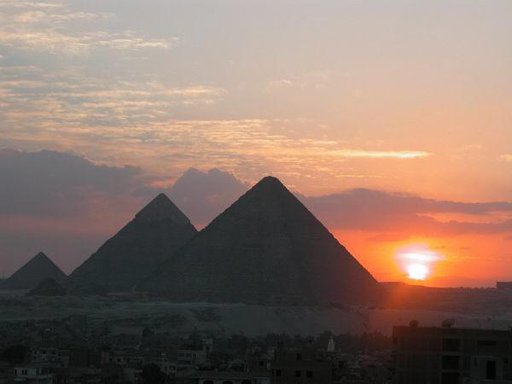
Journey back in time to 1922.
To a time when aeroplanes were very small and did not fly far.

Slide 7
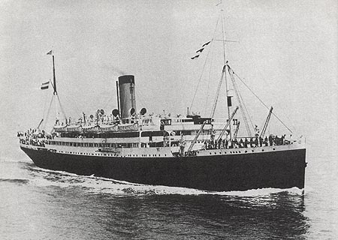
To a time when people travelling to Egypt from Britain went by ship. It took 2 weeks.

Slide 8
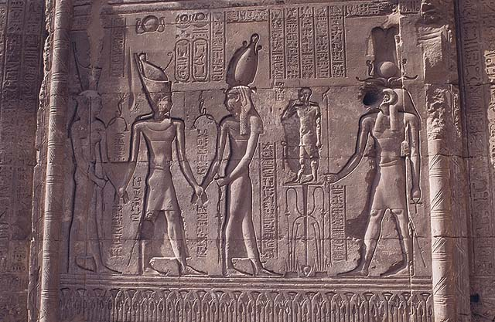
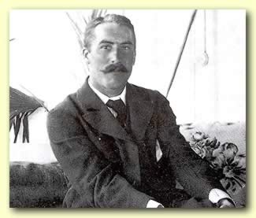
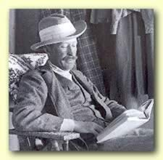
Howard Carter was a British archaeologist working in Egypt.
Howard Carter
Lord Carnarvon
Lord Carnarvan was a rich Englishman with an interest in Egypt. He paid the bills for Howard Carter’s work.

Slide 9
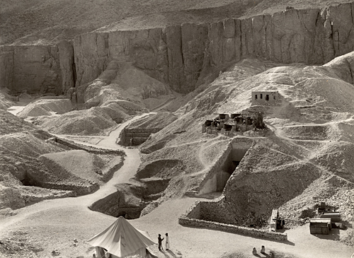
The people of Egypt buried some of their greatest pharaohs in this Valley of the Kings. By 1922 archaeologists thought they’d found them all.
Howard Carter worked out that there was still one tomb left – that of Tutankhamun!

Slide 10
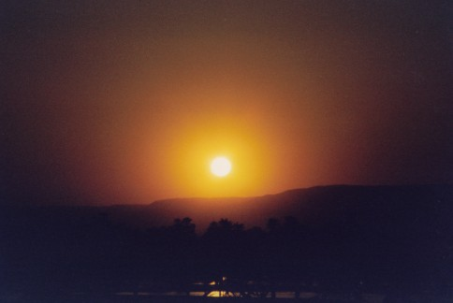
Early morning on the 3rd November 1922, in a hot and dusty valley in Egypt.
Egyptian workers were searching, digging away sand and stones.
They didn’t hold out much hope.

Slide 11
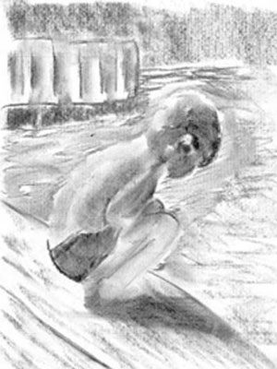
A young boy crouched a few feet away. His job was to fetch water to the workers. He sat digging in the sand with a stick. Suddenly he hit a hard surface.
He dug furiously and found a stone step.
He stared at it – then covered it over and ran to tell Howard Carter what he’d found.

Slide 12
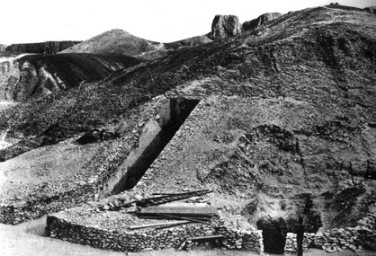
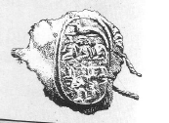
Carter ordered the workers to clear away the sand. Gradually they found 12 more steps.
Then they found the top part of a door made of brick and plaster. On the door was a stamp. This meant the tomb was royal and it was intact.

Slide 13
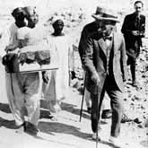
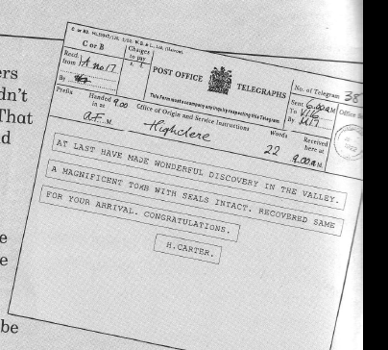
Carter ordered the workers to cover the steps over again so nobody else would find the tomb.
He sent a telegram to Lord Carnarvan in Scotland, asking him to come at once.
How long did it take Carnarvan to arrive?
Carnarvan and his daughter, Lady Evelyn arrived at the town of Luxor 2 weeks later and met Carter.

Slide 14
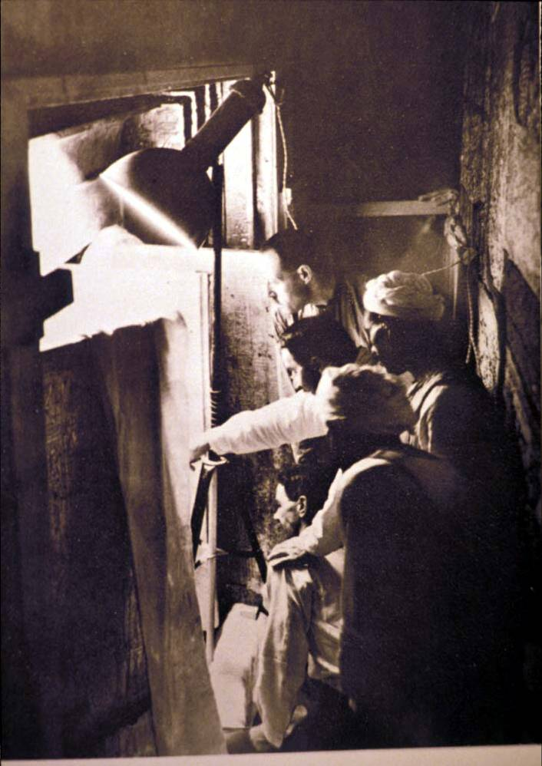
Next day, Howard Carter asked the workers to break down the door. They found a passage way blocked by rubble. Clearing them away they found...
A second door.
Carter took an iron bar and made a tiny hole in the top left hand corner. The bar passed through so the passage was clear.

Slide 15
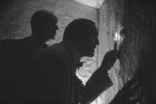
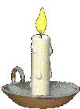
Carter took a candle and put it up to the hole to test for dangerous gas.
Then he widened the hole and looked in.
At first he saw nothing – then his eyes adjusted.
“Can you see anything,” asked Lord Carnarvan
“Yes”, replied Carter
“Wonderful things!”

Slide 16
Both Carter and Lord Carnarvan were desperate to take a closer look. But Egyptian rules said NO!
Archaeologists had to have permission to dig in Egypt. They had to have an inspector with them when they first went in.
Frustrated, they closed up the hole and left one of the workers on guard. Then they got on their donkeys and rode back to Carter’s house.

Slide 17
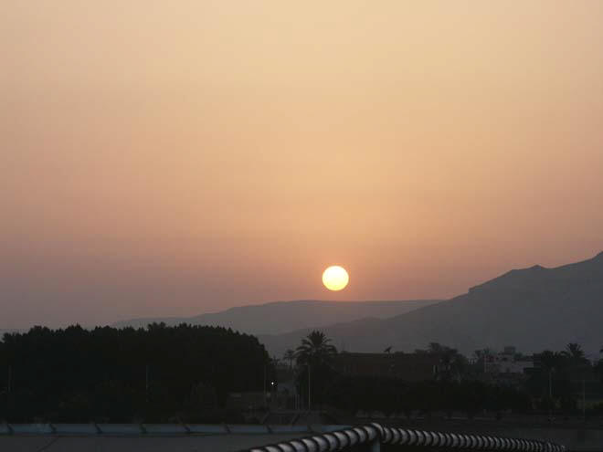
Unable to wait , later that same night Carter returned to the tomb. He made the hole bigger and they squeezed through one by one and dropped onto the floor. They found themselves in a small room.
Over 3000 years had passed since anyone had last entered. They saw a fingerprint left on the painted surface of an oil lamp. The smell of perfume still filled the air.

Slide 18
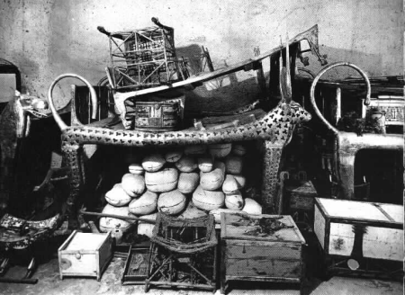
They found many magnificent statues and other items that blinked and glittered in the torchlight. They found a golden throne with figures of Tutankhamun and his wife on it.
But Carter was worried. If this was Tutankhamun’s tomb, then where was his body?
On the wall to the right were 2 life size statues of King Tutankhamun.

Slide 19
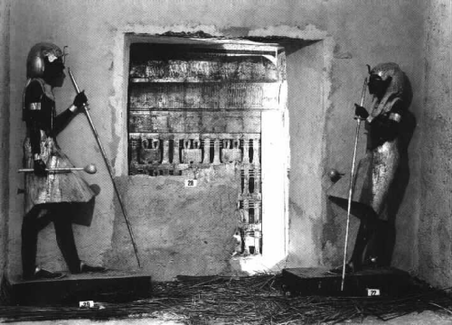
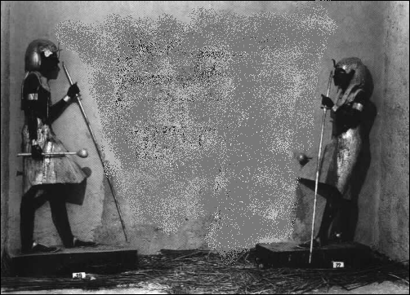
The statues stood opposite each other as if on guard.
Carter realised they marked a sealed up entrance to another room.

Slide 20
Footage and recap of the story:
https://www.youtube.com/watch?v=7ZWB5-aXMXQ
The contents of the tomb:
https://www.youtube.com/watch?v=eYmyYpUFHik

Slide 21
TASK
Create a storyboard to retell the story of Tutankhamun’s tomb discovery. If you want a challenge, write a diary entry instead!
If you get stuck, use the help sheet to prompt key vocabulary and dates.

