Slide 1
Monday 6th July 2020
L.O: To locate and explain the geographical features of Egypt.

Slide 2
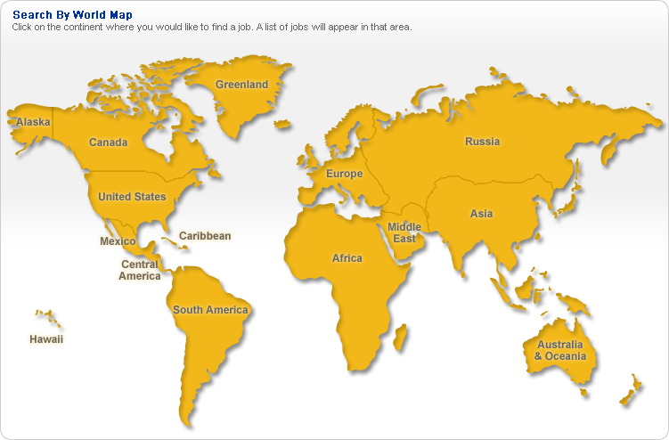
Where is Egypt?
In which direction of Africa is Egypt?
Egypt

Slide 3
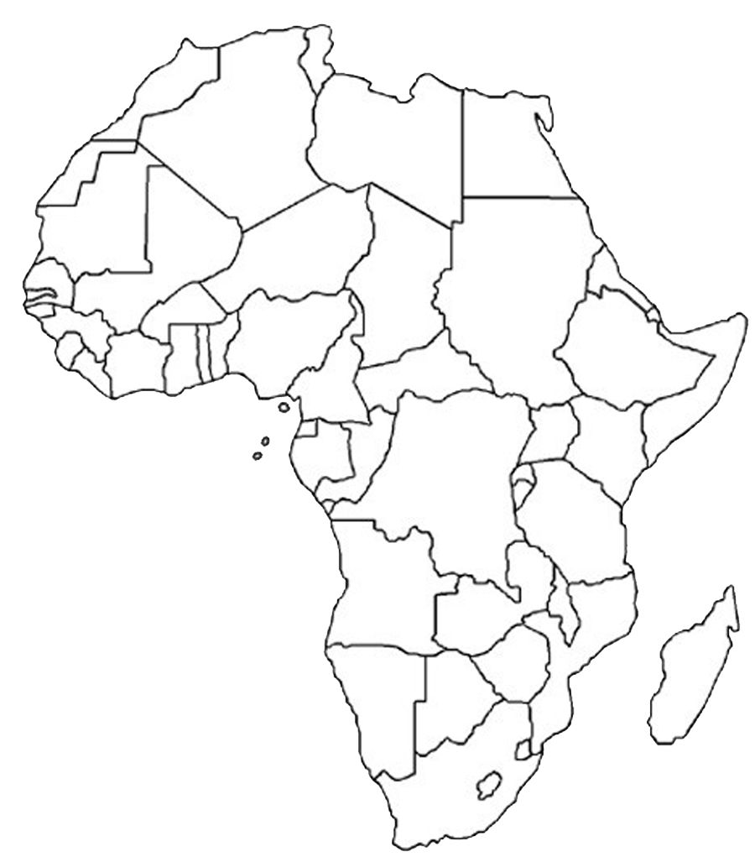
TASK: Using your Atlas, locate the following:
Egypt
Countries that surround Egypt

