Slide 1
L.O. To classify animals native to India
I can explain what it means to classify something
I can recall some of the groups
I can use facts specific to each group to organise given animals
I can create classification questions

Slide 2
What does it mean to classify something?
Dictionary definition – arrange a group of people or things in classes or categories according to shared qualities or characteristics.
Child friendly – organising things based on what makes them similar.

Slide 3
What groups of animals do you know of?
tg

Slide 4
Animal groups
f

Slide 5
mammals
Can you think of an example animal for each group?
amphibians
reptiles
fish
Warm blooded
Live on land and in water
Have hair or fur
Skeleton inside body
Birth live young which drinks mother’s milk
Cold blooded
Live on land and in water
Moist skin
Webbed fin
Skeletons inside body
Lay eggs
Cold blooded
Live on land and in water
Scales, ear holes, dry skin
Skeletons inside body (turtles have one outside too!)
Lay eggs
Cold blooded
Live in water
Fins to move, gills to breathe
Skeletons inside body
Lay eggs

Slide 6
birds
Can you think of an example animal for each group?
insects
arachnids
arthropods
Warm blooded
Live on land and in water
Have feathers, wings, beak
Skeletons inside of body
Lay eggs
Cold blooded
Live on land and in water
Bodies in 3 parts
Most have 2 pairs of wings
Skeleton outside body
Hatch from eggs
Cold blooded
Invertebrate (without spine)
Segmented body
Skeleton outside body
Cold blooded
Mostly live on land
8 legs
Spiders spin webs
Skeleton outside of body
Lay eggs

Slide 7
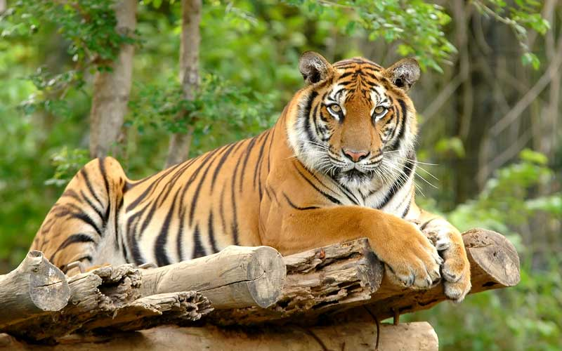
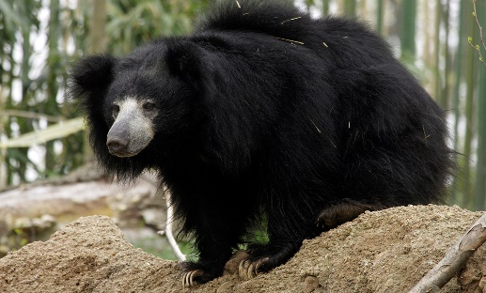
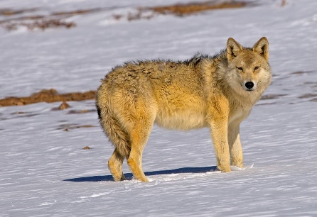
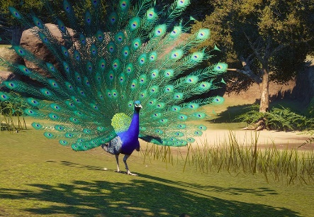
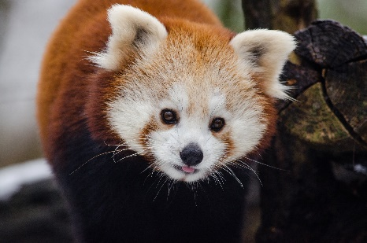
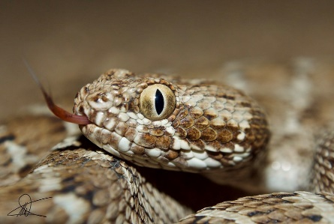
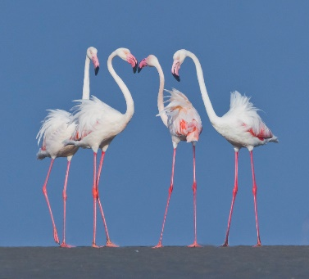
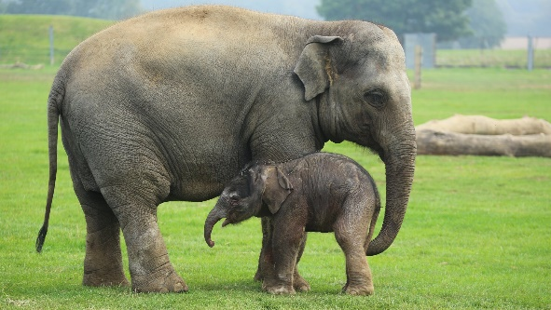
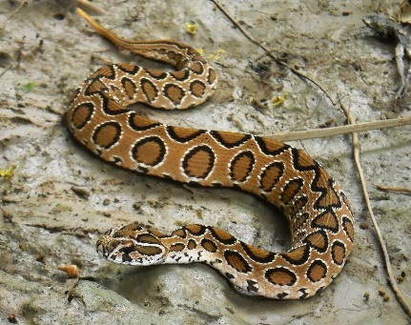
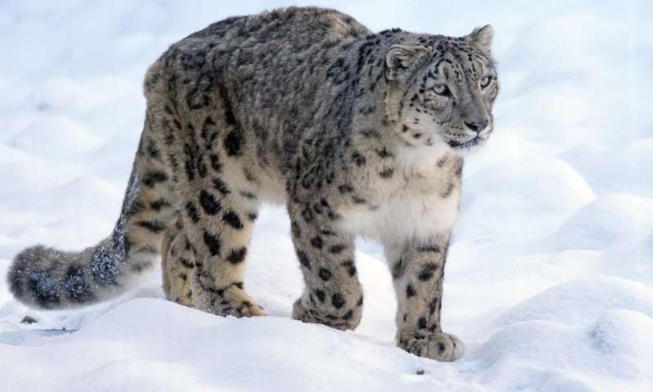
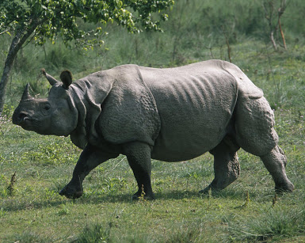
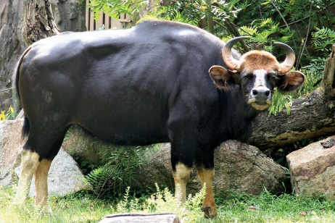
Animals native to India – can you classify them?
Bengal tiger
Indian sloth bear
Himalayan wolf
Peacock
Red panda
Greater flamingo
Asian elephant
Saw-scaled viper
Russel’s viper
Snow leopard
Indian rhino
Gaur

Slide 8
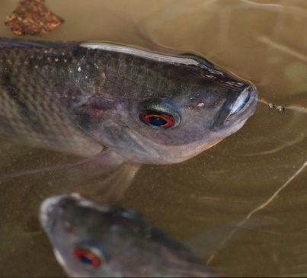
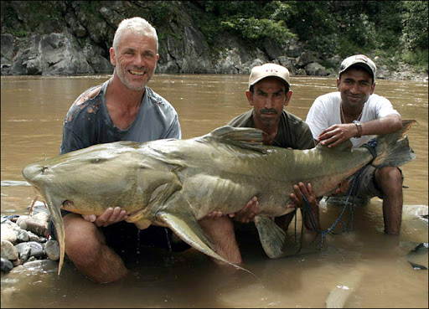
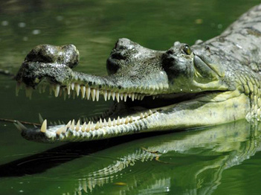
Animals living near the Taj Mahal
The River Yamuna runs along side the Taj Mahal.
It is home to many fish including:
Carp,
Catfish,
Gharial (crocodiles)

Slide 9
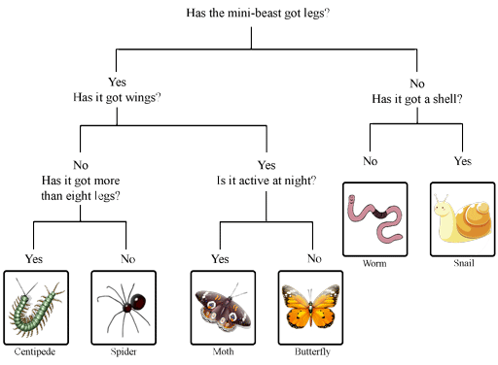
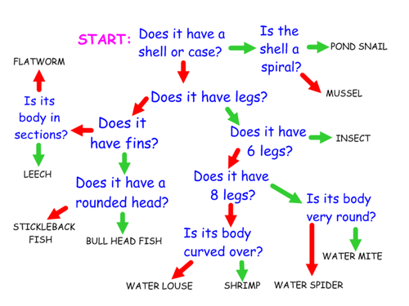
Creating classification keys
Questioning is incredibly important. Look at the examples below, which would be a better classification key? Why?

Slide 10
Creating classification keys
Ensure your questions are specific and have yes/no answers.
In your book, create your own classification key to organise the animals you’ve been given.
Make sure you use some of the facts/vocabulary from the animal group facts we looked at earlier.

