Slide 1
Welcome to Year 6
6J- Miss Jackson
6FS- Mrs Fowles (previously Miss Taylor!)
6F- Miss Farrell

Slide 2
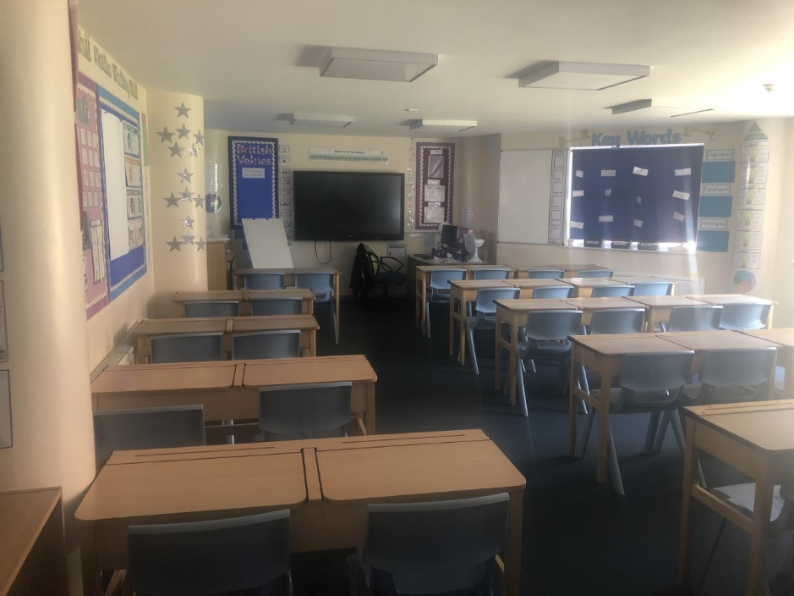
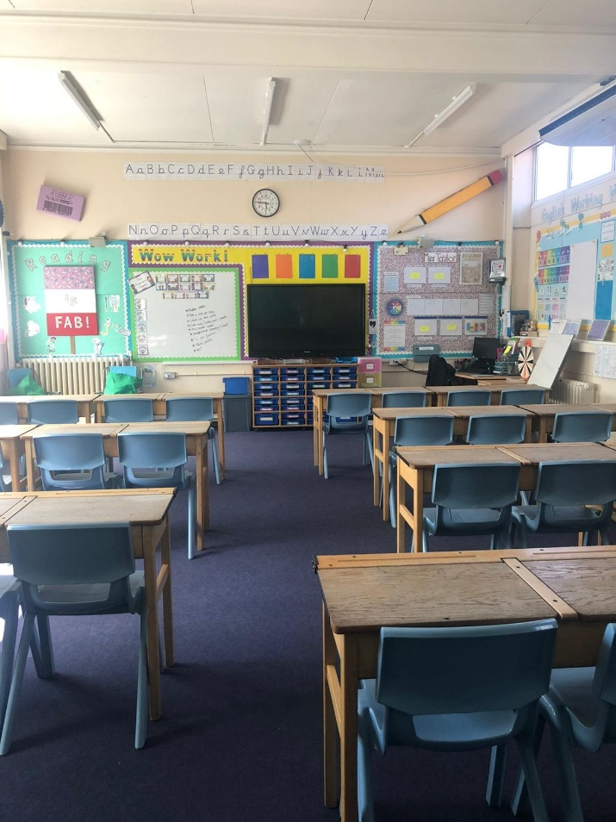
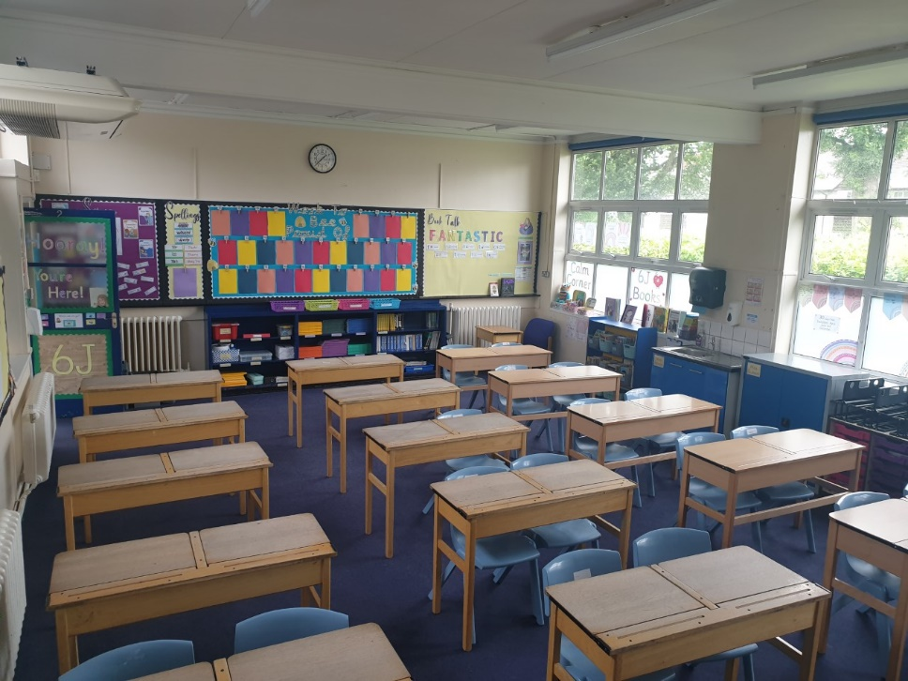
Classrooms
6F
6FS
6J

Slide 3
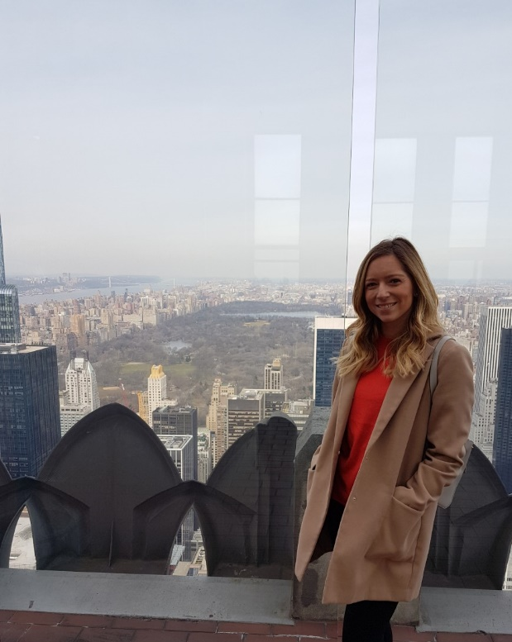
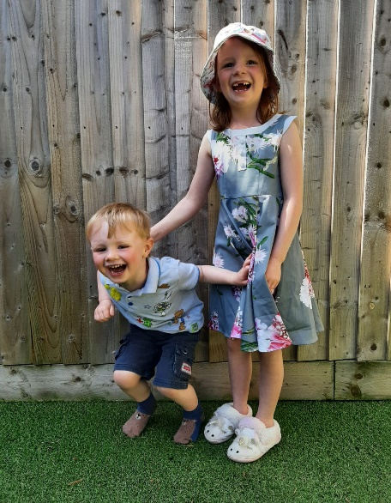
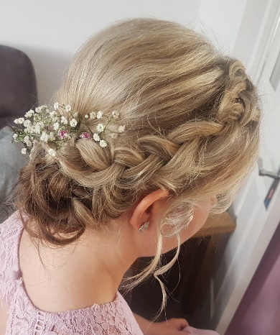
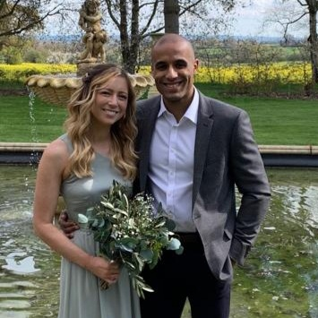
Hello I’m Miss Jackson!
About me…
I love travelling abroad.
To keep fit, I go running and play basketball.
I do wedding hairdressing on some weekends.
I love coffee and drink a lot of it!
I have a niece (Abigail) and a nephew (Samuel).
Pancakes are my favourite food.
My favourite subject to teach is -of course- maths! ☺
I have been teaching at Boldmere for 10 years and have photos of all my old classes in my classroom!
Thoughts from my last class…
’Miss J is the best teacher you could ever wish for.’- Connor
’She is funnier than Mr Glasgow!’- Amelia
’She makes all lessons really fun!’- Pearl

Slide 4
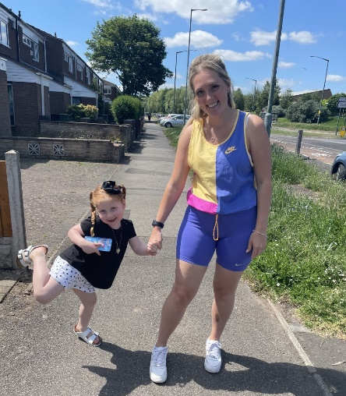
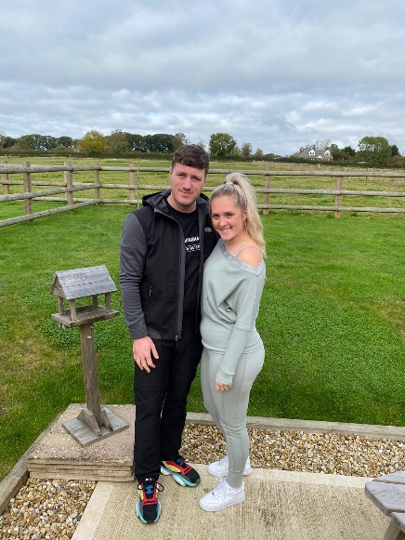
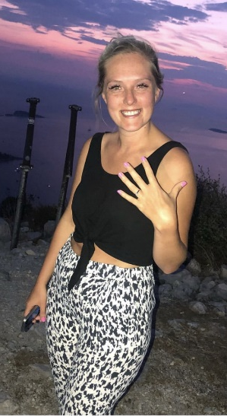
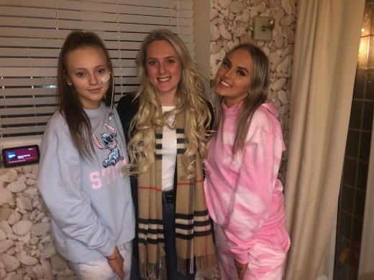
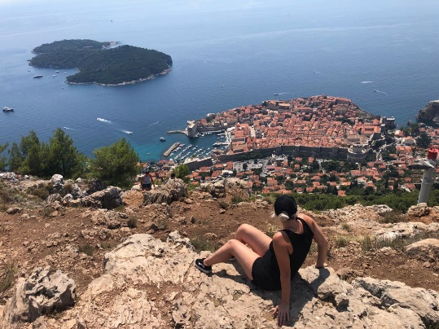
Hello I’m Mrs Fowles
About me…
I’m about to get married (one whole year later than planned) and I’m very excited!
I love to go on holiday to sunny destinations!
I have two younger sisters who both make me very proud!
I enjoy going to the gym, on long walks and on bike rides to keep fit.
I go to Boogie Bounce every Sunday – it’s super fun!
I have a little niece called Gracie and she makes me smile!
My favourite subject to teach is Maths ☺
I love chocolate and a good cuppa tea!
Thoughts from my last class …
She is really funny!’- Edward
’She is nice, kind and helpful!’- Sophie
‘Whenever you are stuck, Miss Taylor’s always there to help you!’- Maesha

Slide 5
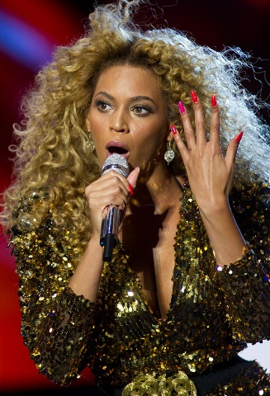
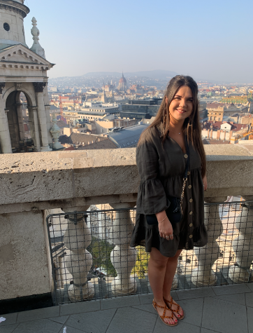
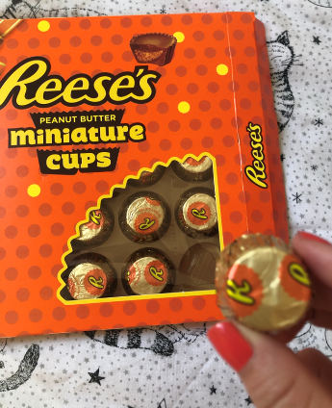
Hello I’m Miss Farrell
About me…
I love spending time with my friends and family!
Cats are my favourite animal (I have two called Zacch and Pixi)!
I love listening to and watching Beyoncé!
Travelling is something I would love to do more of.
I enjoy eating anything with peanut butter in ☺
Shopping is how I like to spend my free time!
I love teaching and creating Art!
Thoughts from my last class …
‘Miss Farrell is thoughtful and kind!’ - Enoch
‘She is a teacher that will have fun with the class and will help you when you need it!’ - Abi
‘Miss Farrell is kind, caring, amazing and fab!’ - Poppie

