Slide 1
Welcome to Year 3
3U – Mr Uppal – First classroom in the corridor
3P – Miss Pipkin – Second classroom in the corridor
3H - Mrs Hannan – Final classroom in the Y3 corridor

Slide 2
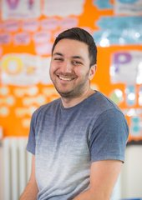
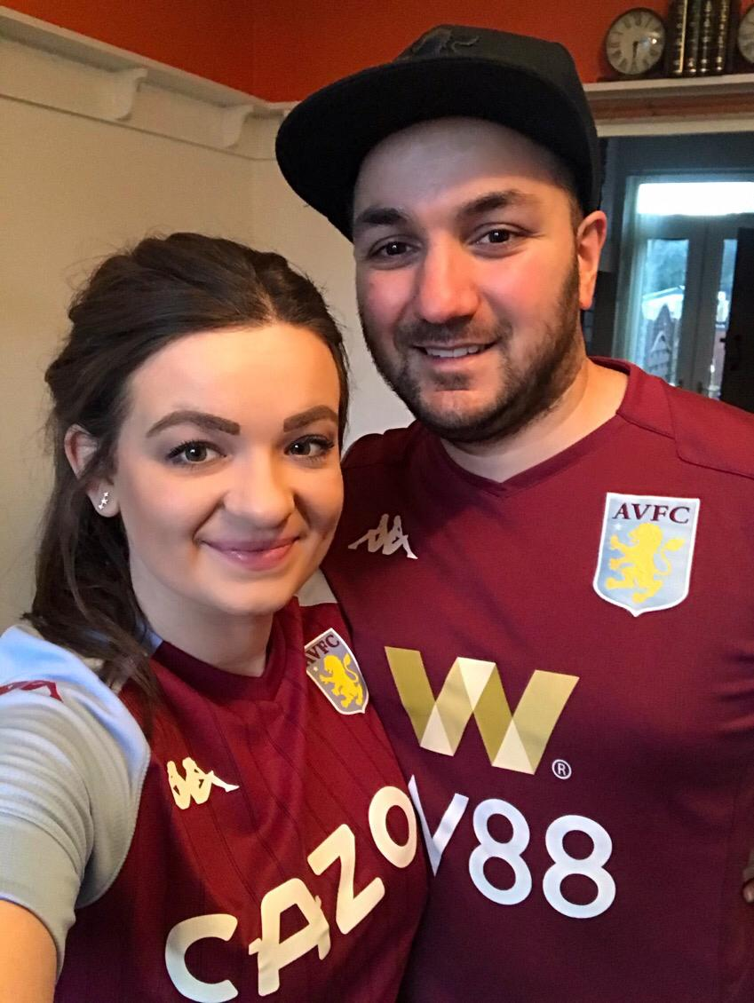
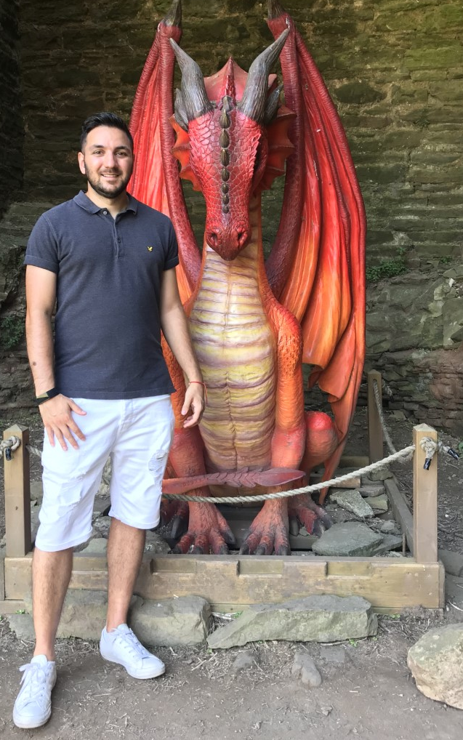
Hello! I’m Mr Uppal!
I love football and I’m a huge Aston Villa fan! I still play myself and coach on the weekends!
If I wasn’t a teacher, I would love to be an astronaut and explore space.
I cant wait to meet you all as 3U!
I hope you have a fantastic summer and get lots of rest!
My favourite books are the Harry Potter books. I have even visited the Harry Potter studios!
You are going to be the 10th class I have ever taught; I am now in double figures!

Slide 3
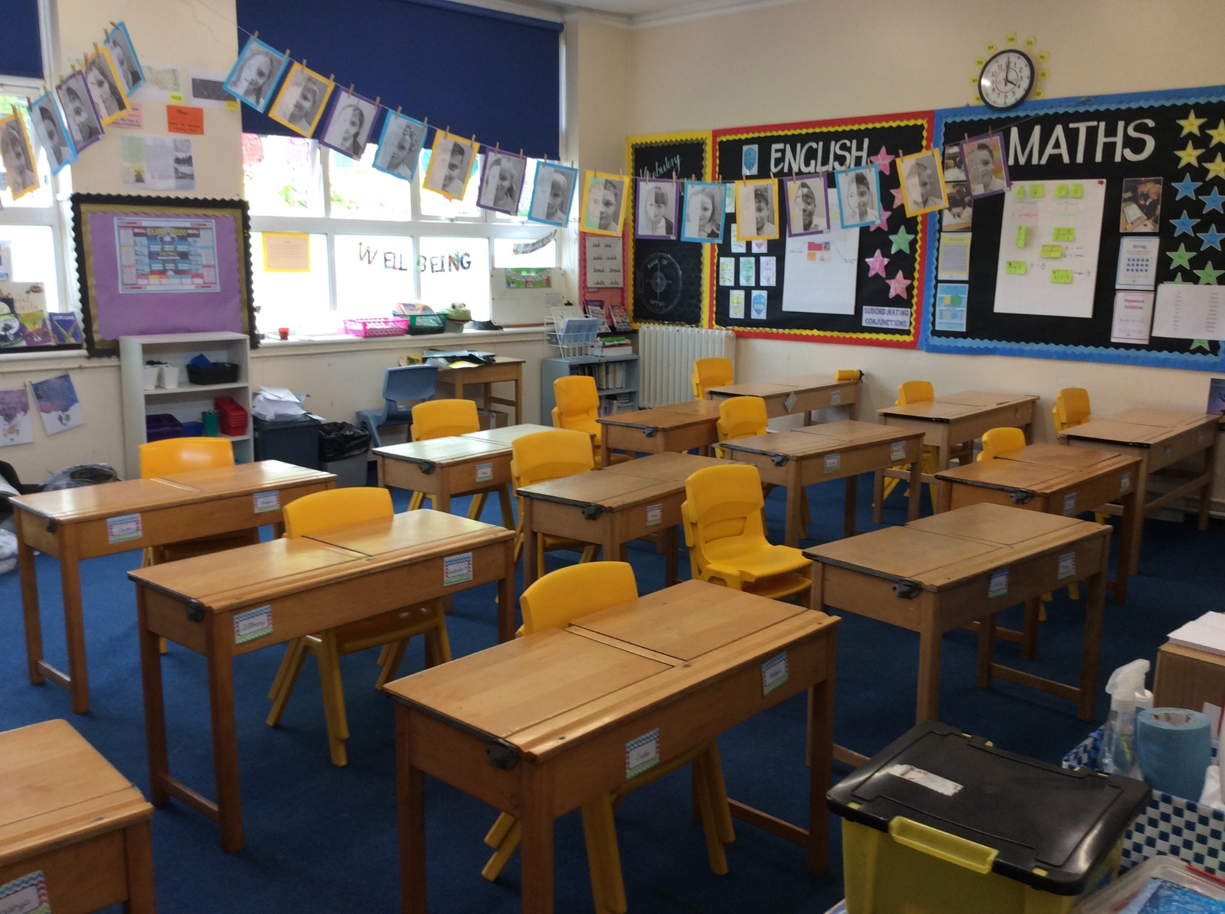
This is the 3U classroom!

Slide 4
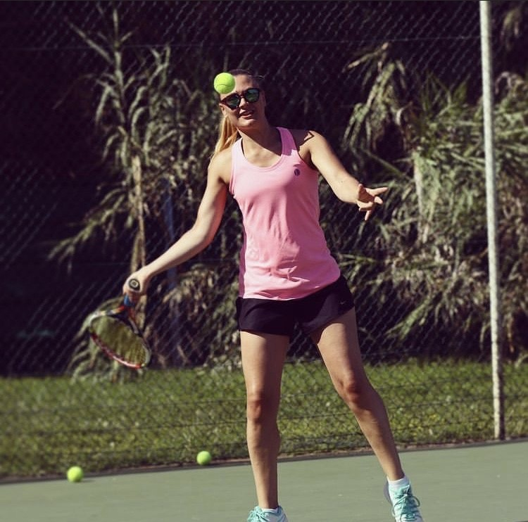
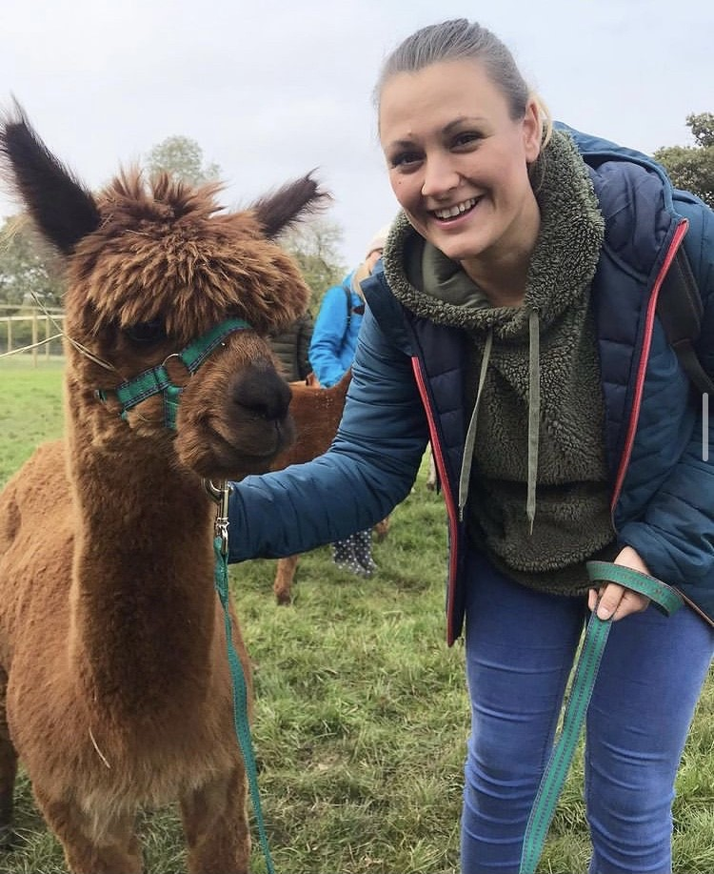
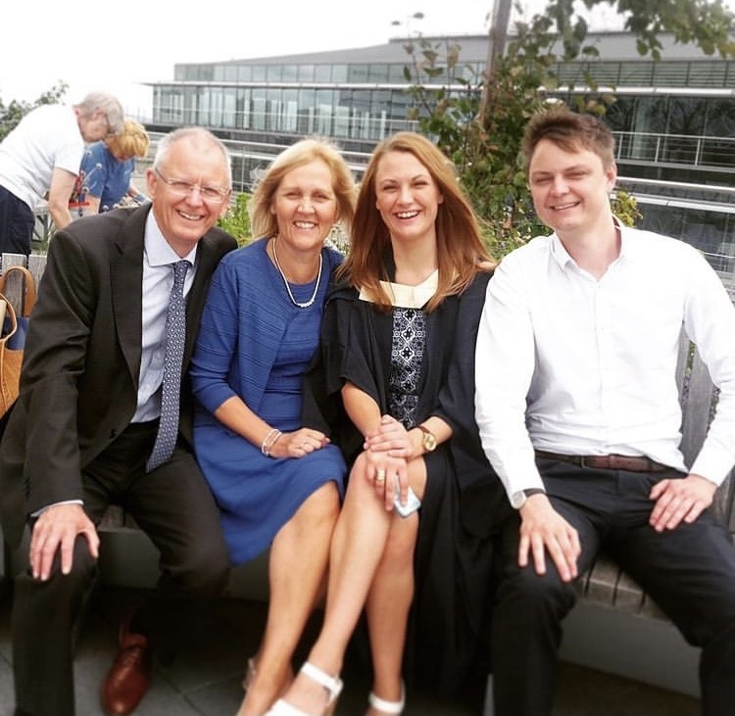
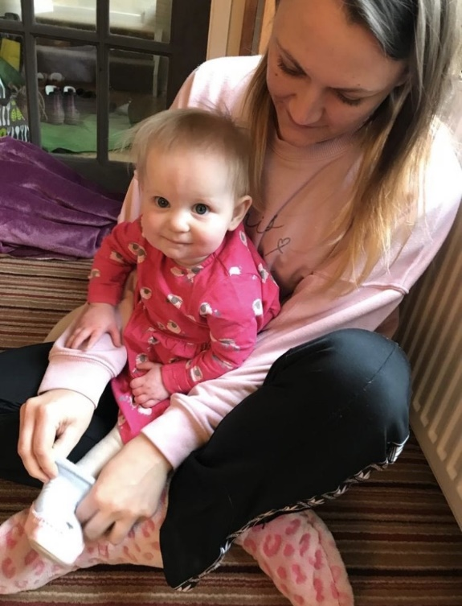
Hello! I’m Miss Pipkin ☺
I am a keen tennis player!
I love animals and being outdoors!
I value my friends and family, and take pride in being a fun auntie!
I’m very excited to be in 3P again!
I have two bunnies, Derek and Daisy.
Have a fantastic summer!

Slide 5
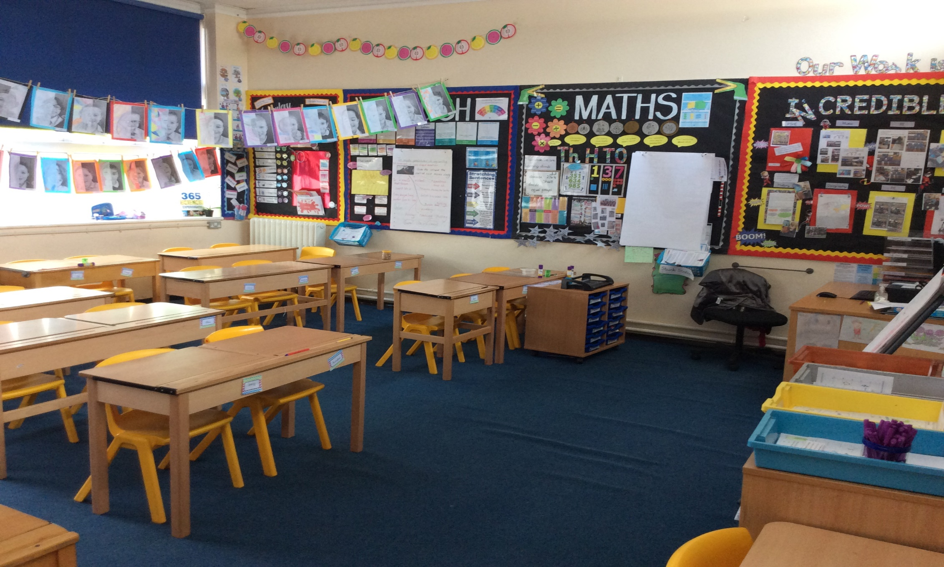
This it the 3P classroom!

Slide 6
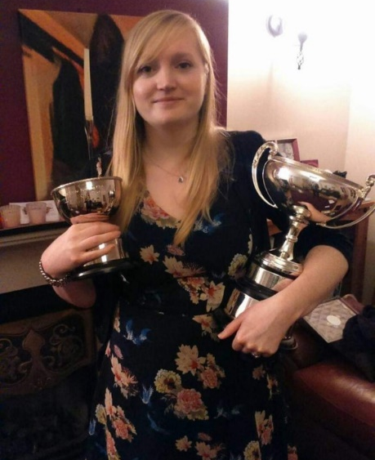
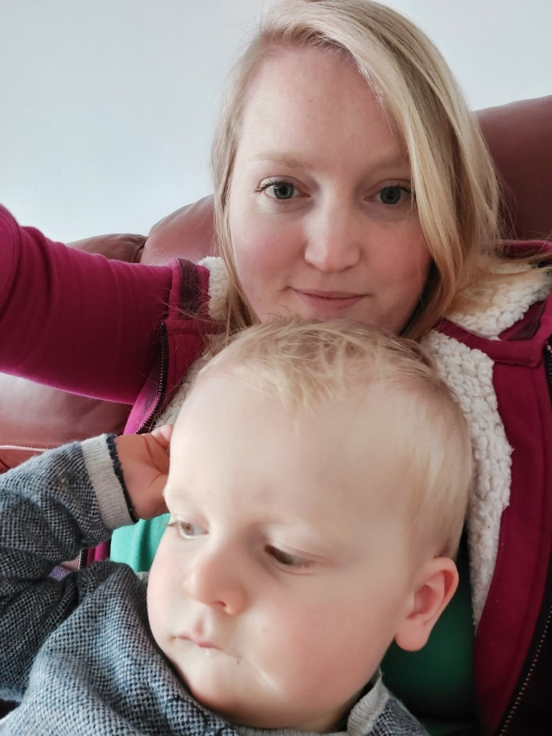
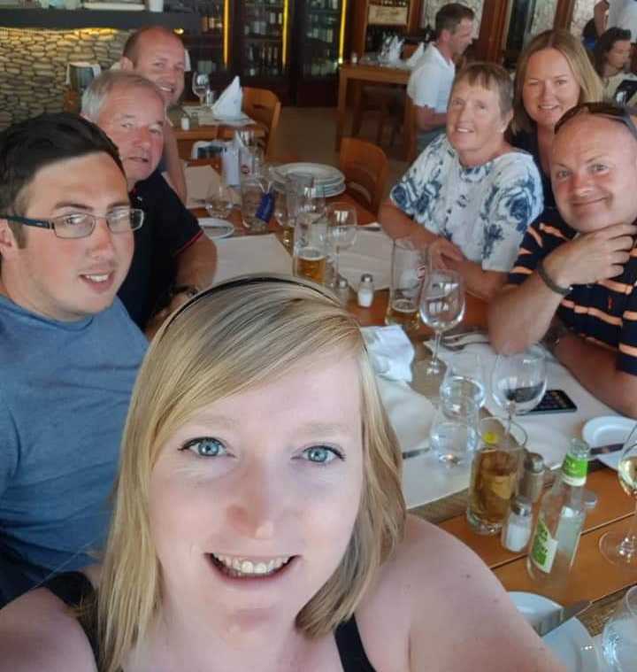
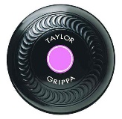
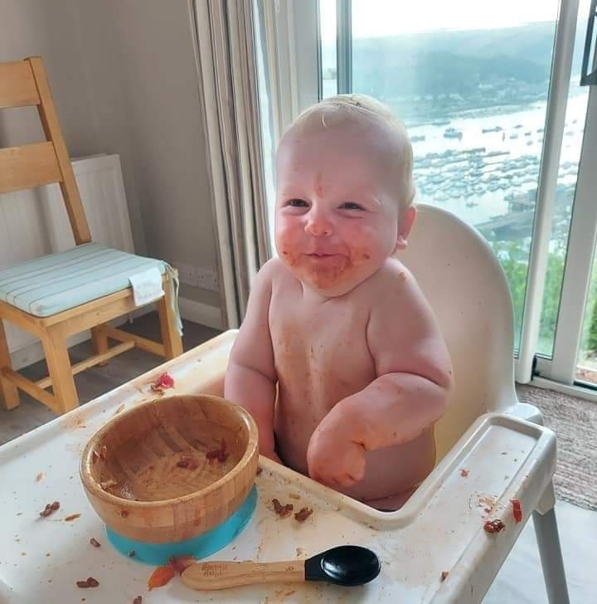
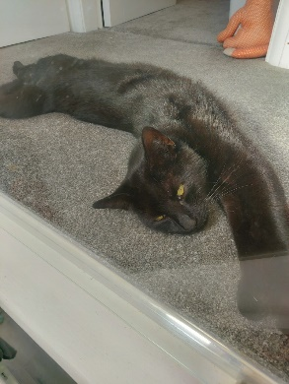
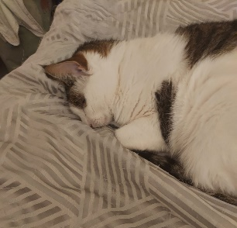
Hello! I’m Mrs Hannan ☺
I am a keen crown green bowls player! This is me when I won my club trophies.
I really enjoy spending my holidays with my family!
I value my friends and family, and love being a mummy! This is Finley and he is nearly 2 years old!
Have a fantastic summer and enjoy your well deserved break!
I have two cats, Jessie and James.
I support West Bromwich Albion.

Slide 7
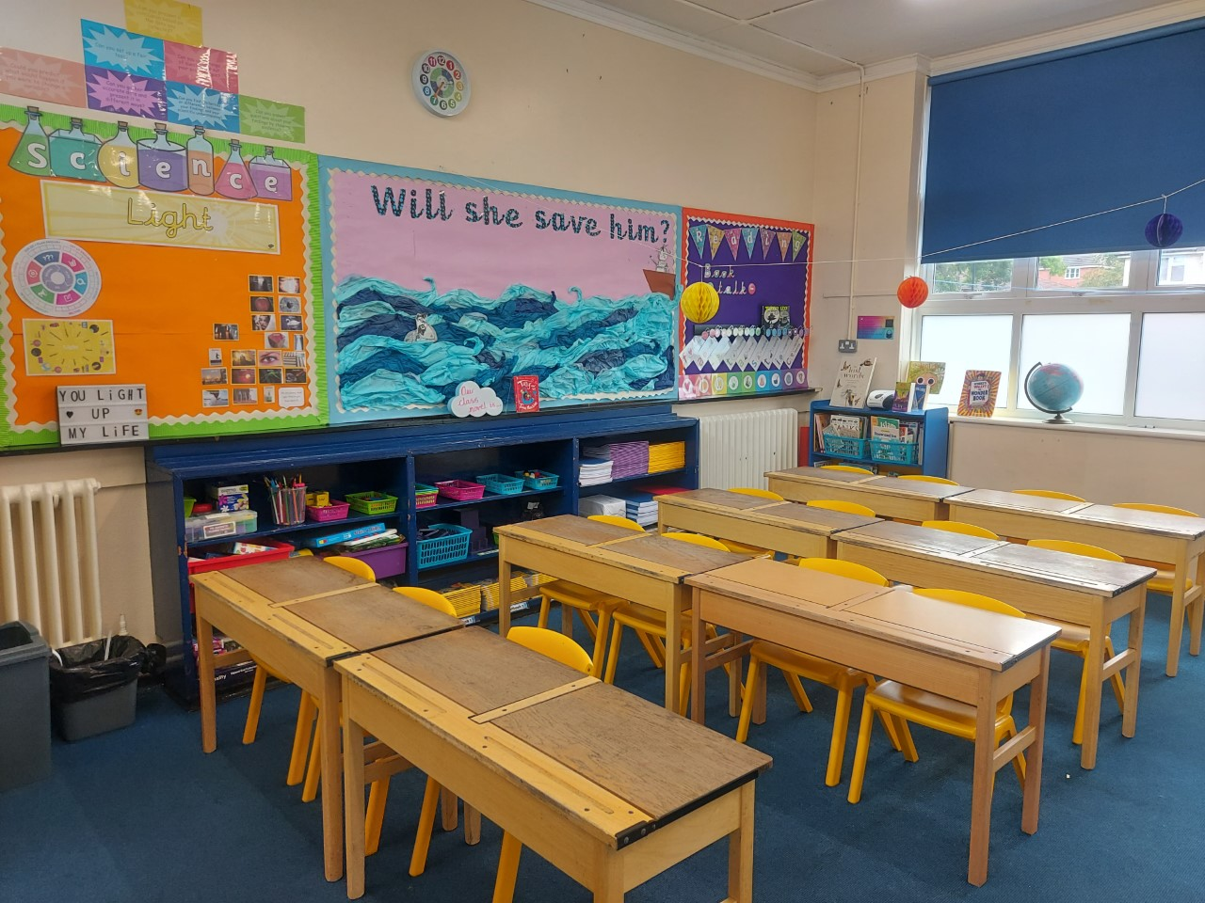
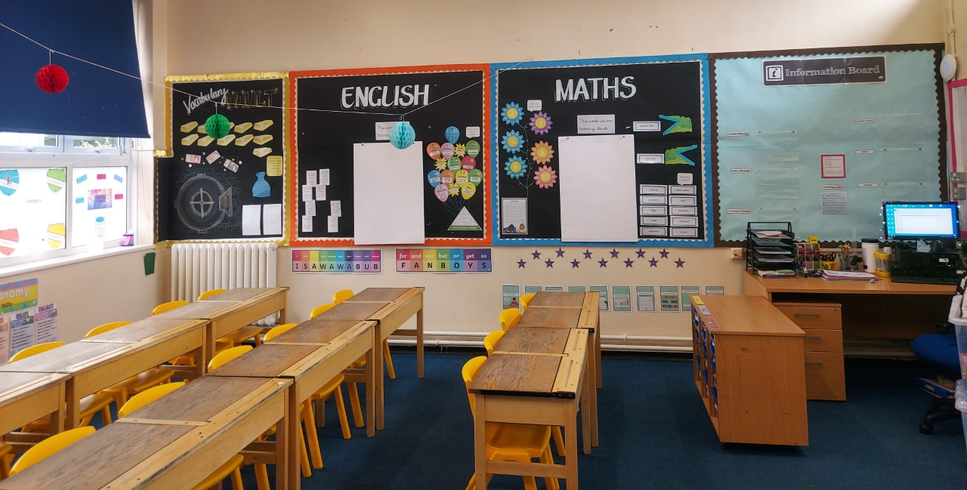
This is our classroom next year ☺

