Slide 1
Year 4 Residential – Whitemoor Lakes Wednesday 12th – Friday 14th February, 2020

Slide 2
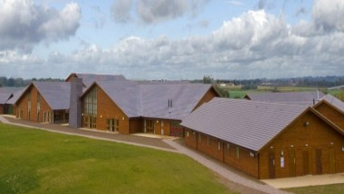
Whitemoor Lakes
Whitemoor Lakes is an outdoor activity centre in South Staffordshire, approximately 30 minutes away.
Opened in 2011
All Whitemoor Lakes staff undergo training on how to do their activities to meet specific needs of groups.

Slide 3
Purpose of visit
As a school, we see our Year 4 residential as the perfect opportunity for the children to have new experiences with activities they wouldn't get to do in a normal school day – this leads to them develop their: independent skills; their ability to problem solve; and to increase their understanding of the importance of working as a constructive team.
From past experiences, I have seen that these type of residential visits improve independence, problem solving skills, teamwork, confidence and communication skills
It is also designed to prepare children for the longer residential they may attend in year 6.
To make new friends
To have lots of fun!

Slide 4
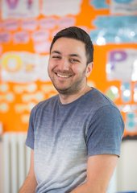
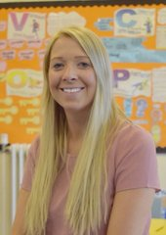
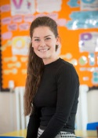
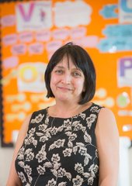
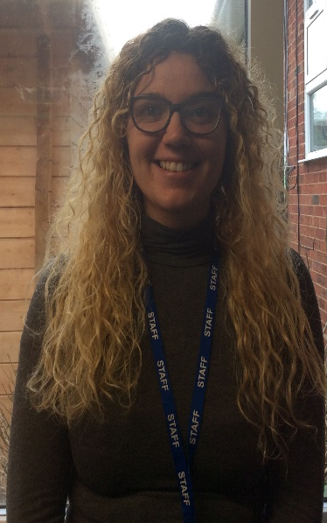
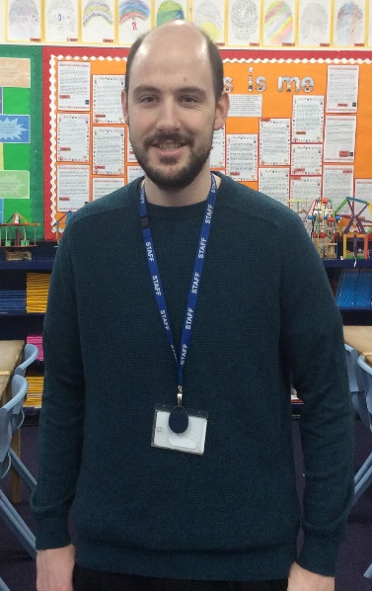
Staff Attending
Mr Uppal
Mrs Mutch
Mrs Kilday
Miss Walker
Mrs Eccles
Miss Pritchard-Jones
Ms Gonzalves
Mr McEwan

Slide 5
Outline of day/activities
Each day consists of 4 day time activities and 1 night time activity:
Breakfast
9:30 – 11:00 – Session 1
11:30 – 13:00 – Session 2
Lunch
14:00 – 15:30 – Session 3
16:00 – 17:30 – Session 4
Dinner
19:00 – 20:30 – Session 5

Slide 6
List of activities that children will be doing …
Abseiling
Archery
Climbing
Circus Skills
Eggs can fly
High ropes
Problem Solving
Team Games
Extreme Sports
Disco

Slide 7
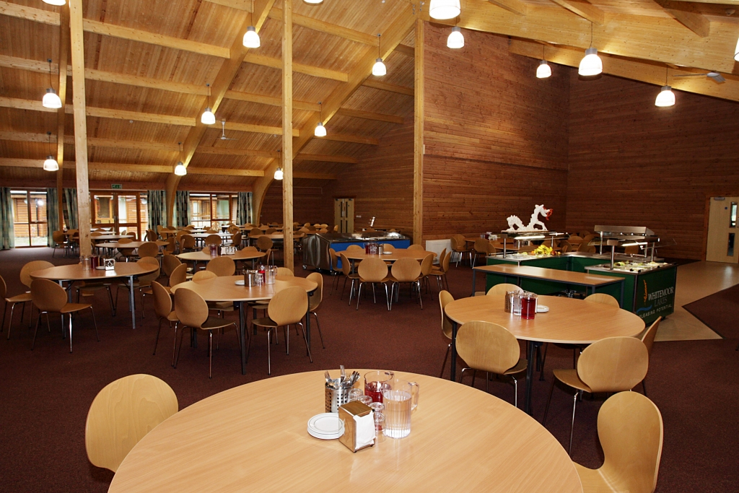
Meals
Three hot meals a day.
Vegetarian options available and all other dietary requirements are provided for.
Drinks available at all times.
Tuck – to be sent in, in a clearly labelled bag.

Slide 8
Accommodation

Slide 9
Sleeping Arrangements
Separate boys and girls dorms (minimum of 4; maximum of 5 children per dorm). (No boys allowed in girls’ dorms and vice versa)
Dorms have ensuite facilities.
Each lodge comes with its own lounge fully equipped with a kitchenette, TV, DVD and projector screen
Teacher rooms located in close proximity to children’s rooms (children made aware of their location in case they are needed in the night).
Night time / first aider supervisor provided by the centre available 24 hours a day.
Dorms and activity groups organised by school staff.
All bed linen will be provided by Whitemoor Lakes.

Slide 11
Please ensure everything is clearly labelled.

Slide 12
Money
Children are recommended to bring in £5-£10 (preferably in coins.)
In the communal area, children can play table tennis, pool and table football for 50p a go.
In the shop, small items are available to purchase. The maximum price of these items is £2.50.
No money to be spent on food – tuck should be sent in separately.

Slide 13
Contact with home
Children will not be able to contact home during their stay.
A parent mail – and tweet if possible - will be sent detailing our safe arrival when we get to the centre.
Twitter updates will be given (poor reception leads to intermittent online updates).
Parents only contacted in an emergency.
Emergency contact details
School mobile number – 07512 462 356

Slide 14
Departing – Wednesday morning
Drop your child – along with their luggage – in the main school hall from 8:30am
Here, children will be registered and allocated to a coach (Coach 1 and Coach 2) and then you put their luggage next to the correct sign (we will let you know Wednesday morning which coach they are.)
Children should be in own clothes – there is no need for school uniform at all for the duration of the residential – and all money and medical items (both clearly labelled) to Mr Uppal, Mrs Mutch or Mrs Kilday.
We will be do a fun activity at school and leave at 10:00am.
Please ensure you child is provided for a packed lunch on this day as we will be eating a packed lunch at Whitemoor Lakes.

Slide 15
Last day and travelling back
On Friday, we complete two morning activities and then have lunch at Whitemoor Lakes
We aim to leave at 2:00pm.
Children will be returned to school and can be collected at 3.45pm from the school hall. Please remember to collect any medication, etc from staff.
A parentmail will be sent out before our expected arrival and we will try and provide twitter updates too.
This is all traffic permitting!

Slide 16
Any questions?

